Slide 1


Secure Multimedia Communication
Industry Project
Final Presentation
Project Mentor :
Dr. Prashant Kanade
Mrs. Yugchhaya Galphat
Group Number : 18
Group Members :
Ashwin Pansare D17B 43
Karan Punjabi D17B 49
Aashish Raheja D17B 51
Kartikey Verma D17B 65

Slide 2
Content
Introduction to Project
Lacuna in the existing systems
Problem Definition
Project Scope
Testing of Existing System
New Methodology employed
Hardware, Software, tools and the constraints
System Block Diagram
Screenshots of Execution
Conclusion
References

Slide 3
Introduction to Project
In today’s world privacy and security is of utmost importance to an individual.
Secure messaging allows to securely exchange documents between users, healthcare providers, organizations and customers. It has already replaced vintage forms of exchanging documents such as fax, post and email.
Currently all other messaging services are hosted on Third party cloud platforms mainly Google and AWS cloud services. This raises concerns about privacy as the third party has access to our private data.
The System under consideration aims to provide the users a real time off the grid secure and private multimedia communication system.

Slide 4
Lacuna in the existing system
WhatsApp and other Applications have the option of verifying the public keys of users, but the mechanisms employed by it are: not robust and serious vulnerabilities from session hijacking.
The way WhatsApp handles the backup mechanism does not provide true end-to-end encryption.
The backup copy is stored on the cloud in plain text.
There is no truly indigenous messaging application.

Slide 5
Problem Definition
To develop a Mobile/Desktop Application which will include the following functionalities:
A user will be able to send any type of message(text,video,documents)
Transfer of the message will be encrypted/decrypted from both sender and receiver sides.
Transfer of the message will not include any third party servers like AWS and will be deployed on servers in own premises

Slide 6
Project scope
Detailed Study and evaluation of existing system developed
To install and setup the Previous project using cookbook provided
To understand all the encryption techniques employed in the existing project.
Test the existing system for all possible combinations of devices and networks
Project Scope Stage-1
Rectify the errors in previous system
Make it operational for all devices and network combinations
Making it operational for audio and video messages apart from general text messages
Project Scope Stage-2
The entire system was reconstructed, in order to get an understanding of how we can transmit messages effectively using a more resilient encryption layer
Evaluation, selection and implementation of a better encryption algorithm enabling the system to be more efficient (XOR encryption layer replaced with Hill Cipher Algorithm)
Modifying the Hill Cipher Algorithm to enable the system to handle large message size
Others Changes - adding a status bar while transmission of the messages, enabling the server to start automatically, dockerizing the file

Slide 7
Testing of Existing System
Successfully installed setup of the project built previously using the cookbook provided and tested it for all possible combinations of device and network combinations
Mobile - Mobile,
Mobile - Desktop,
Desktop - Mobile
Desktop - Desktop
For all above the combinations of devices connected to the same network as well as different network.
Making it operational for audio and video messages apart from general text messages
The errors present in the previous cookbook were rectified as well as updated in the present cookbook.

Slide 8
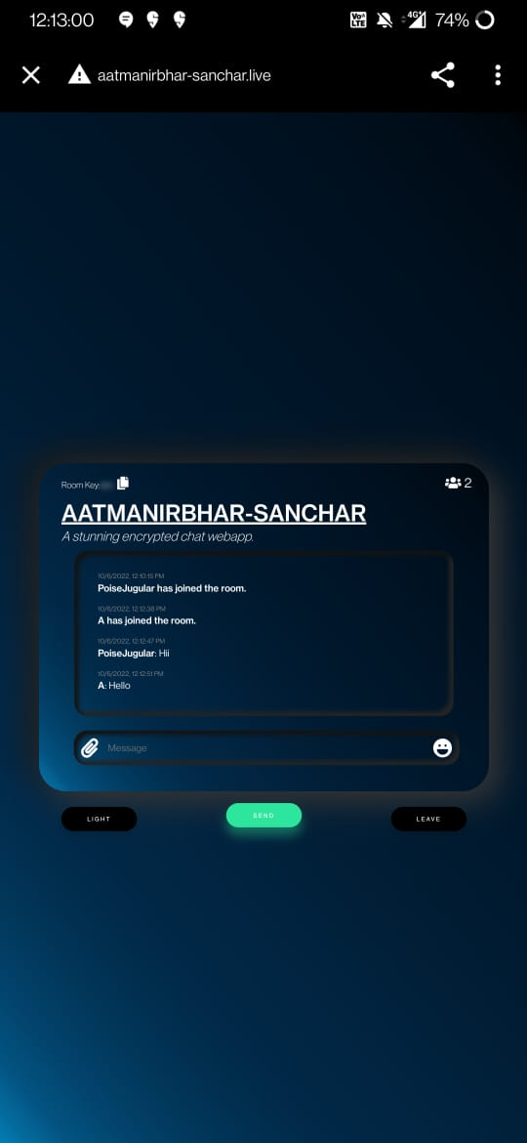
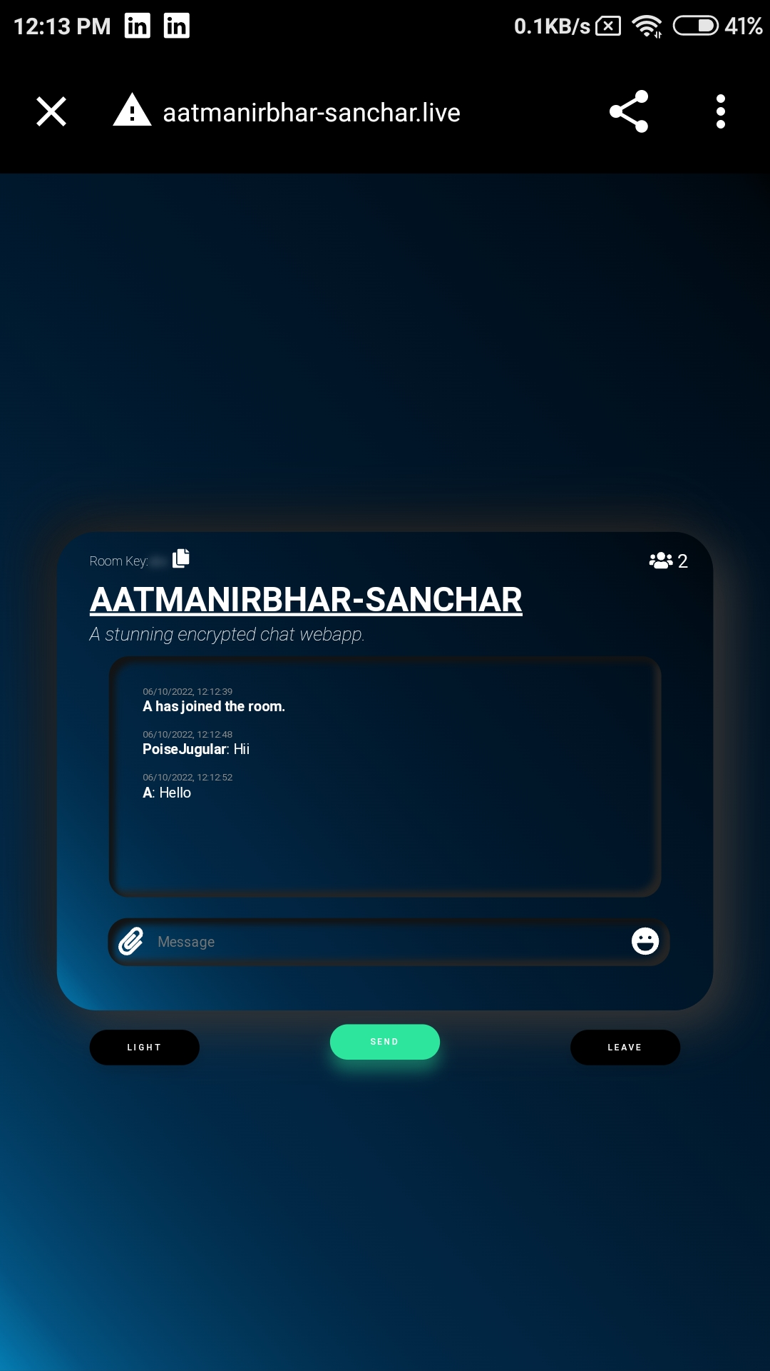
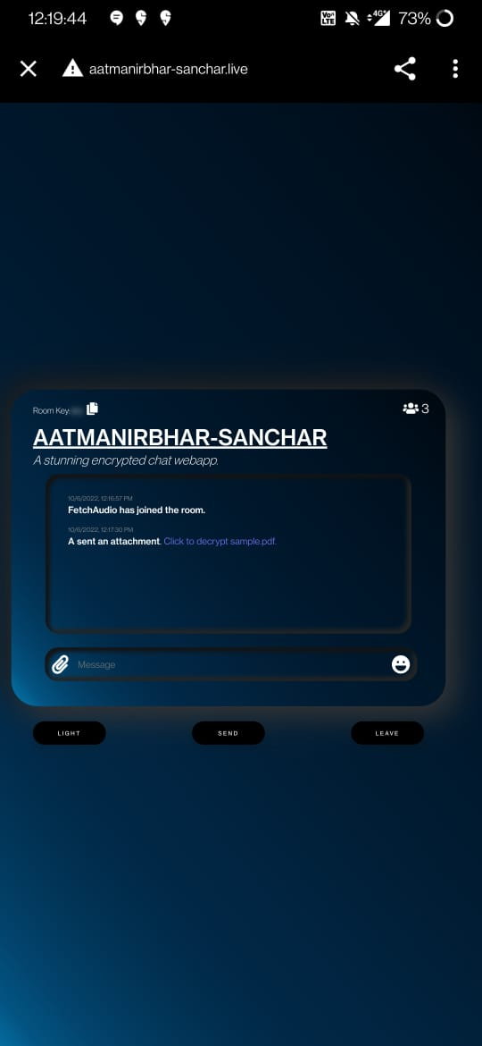
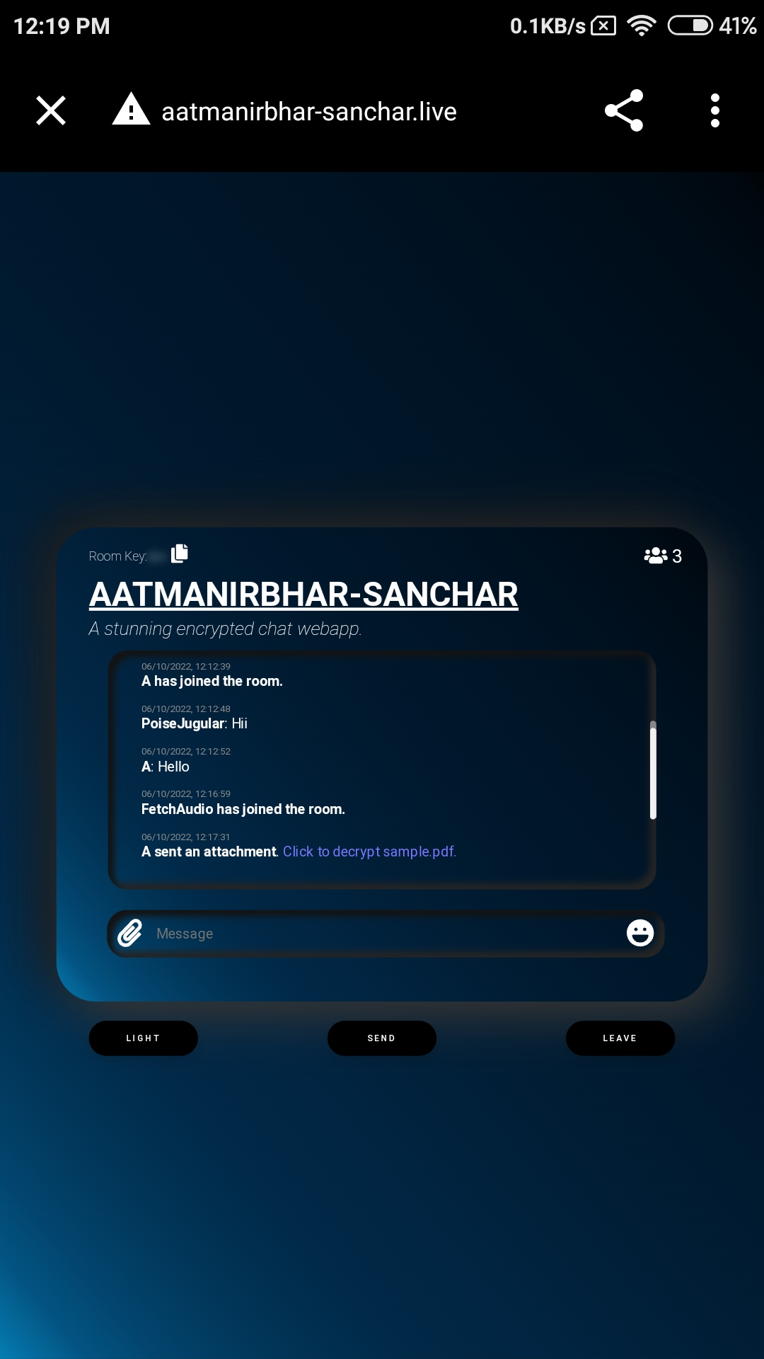
Testing the application
Mobile to Mobile

Slide 9
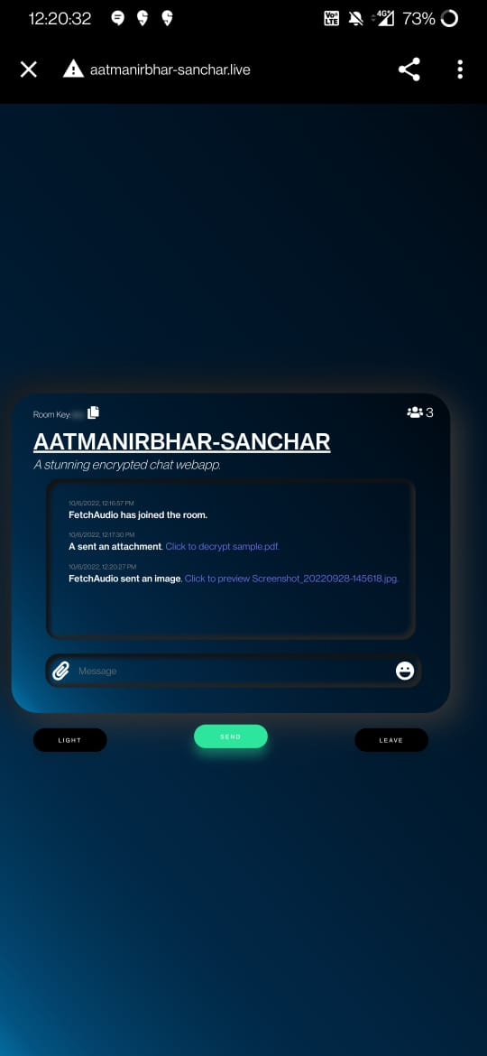
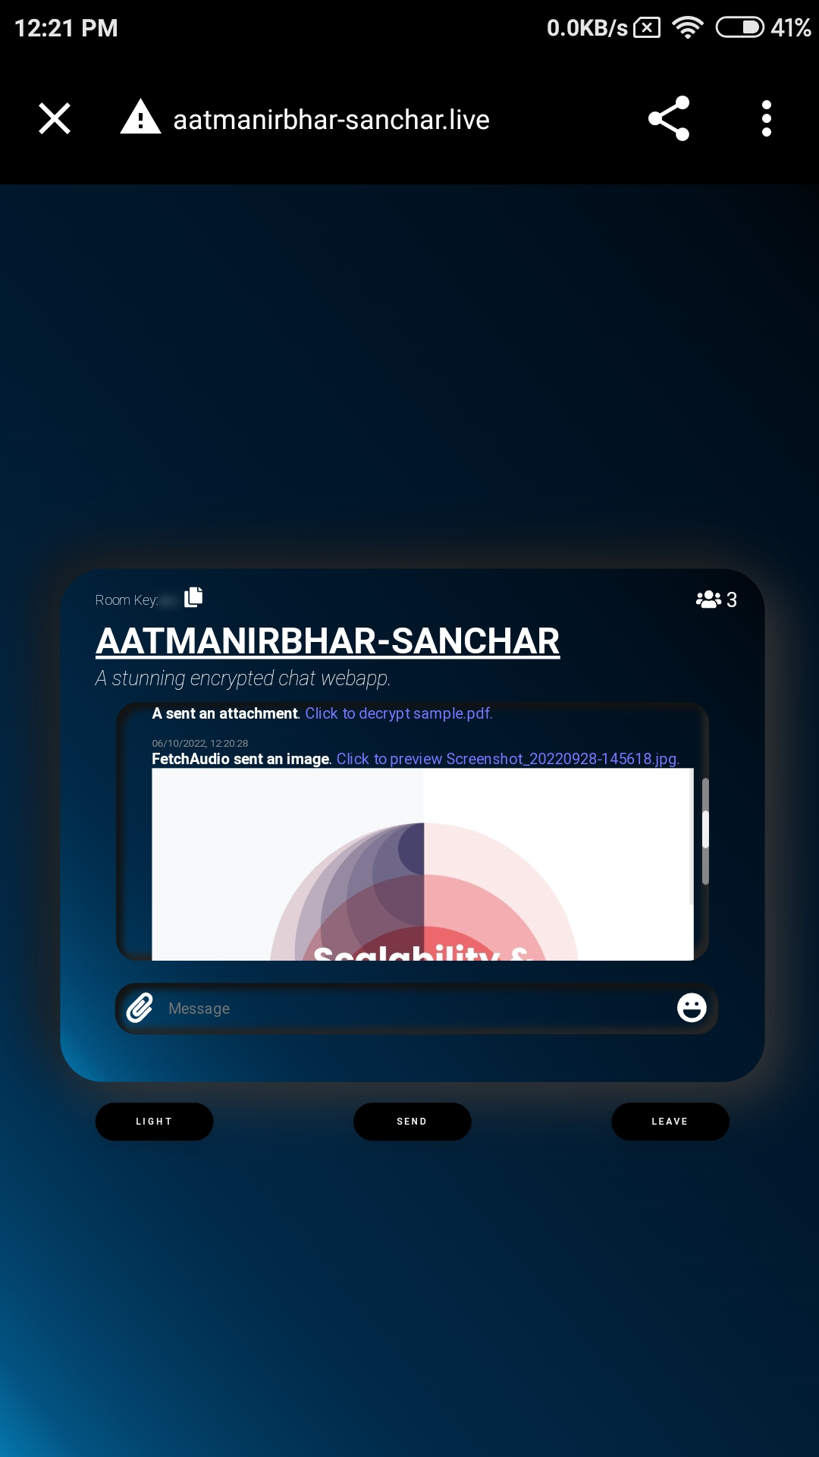
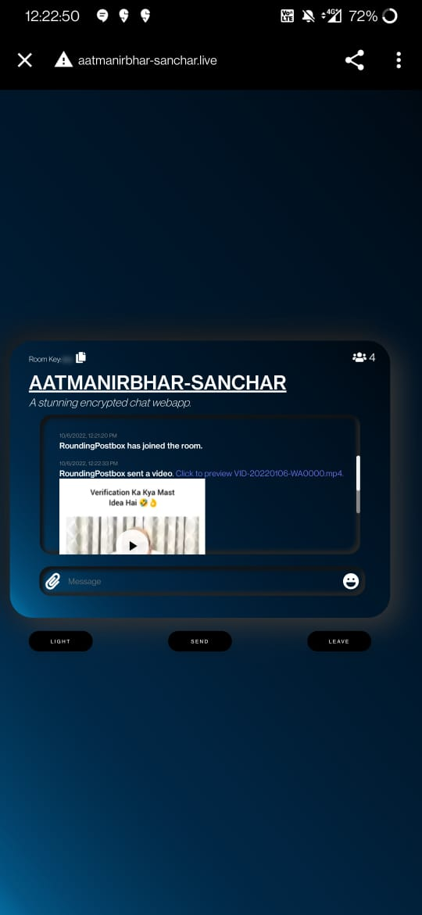
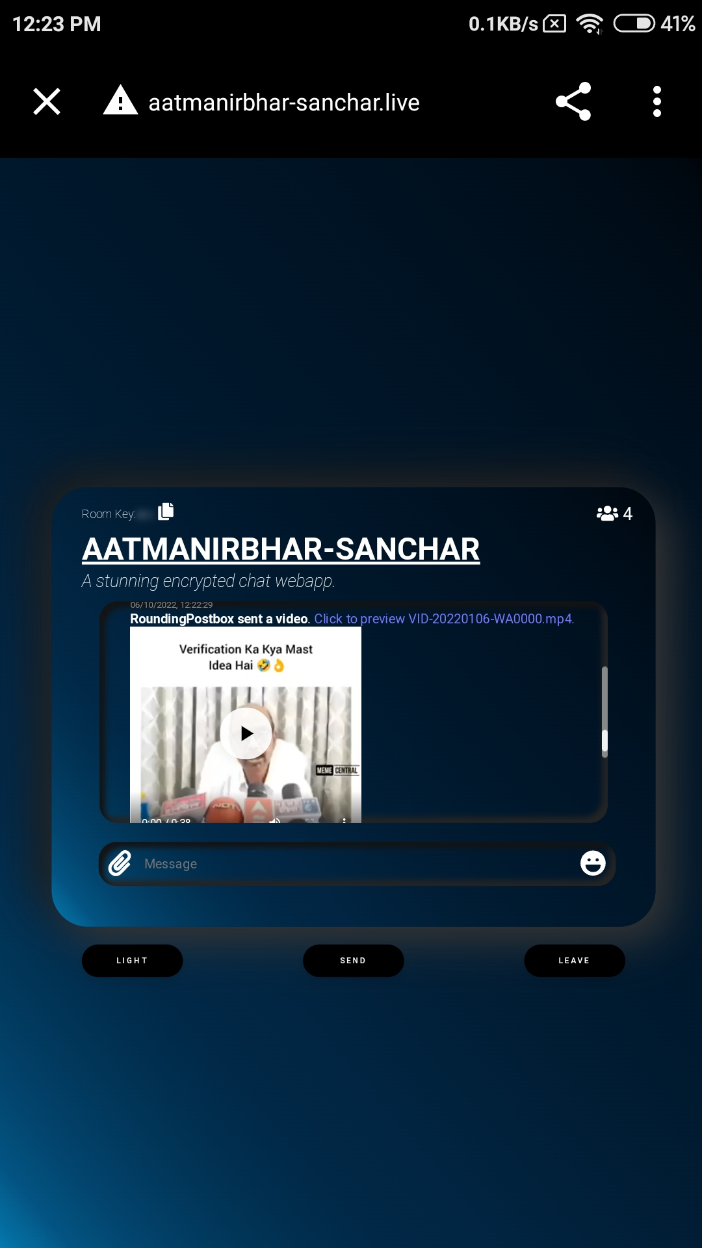
Testing the application

Slide 10
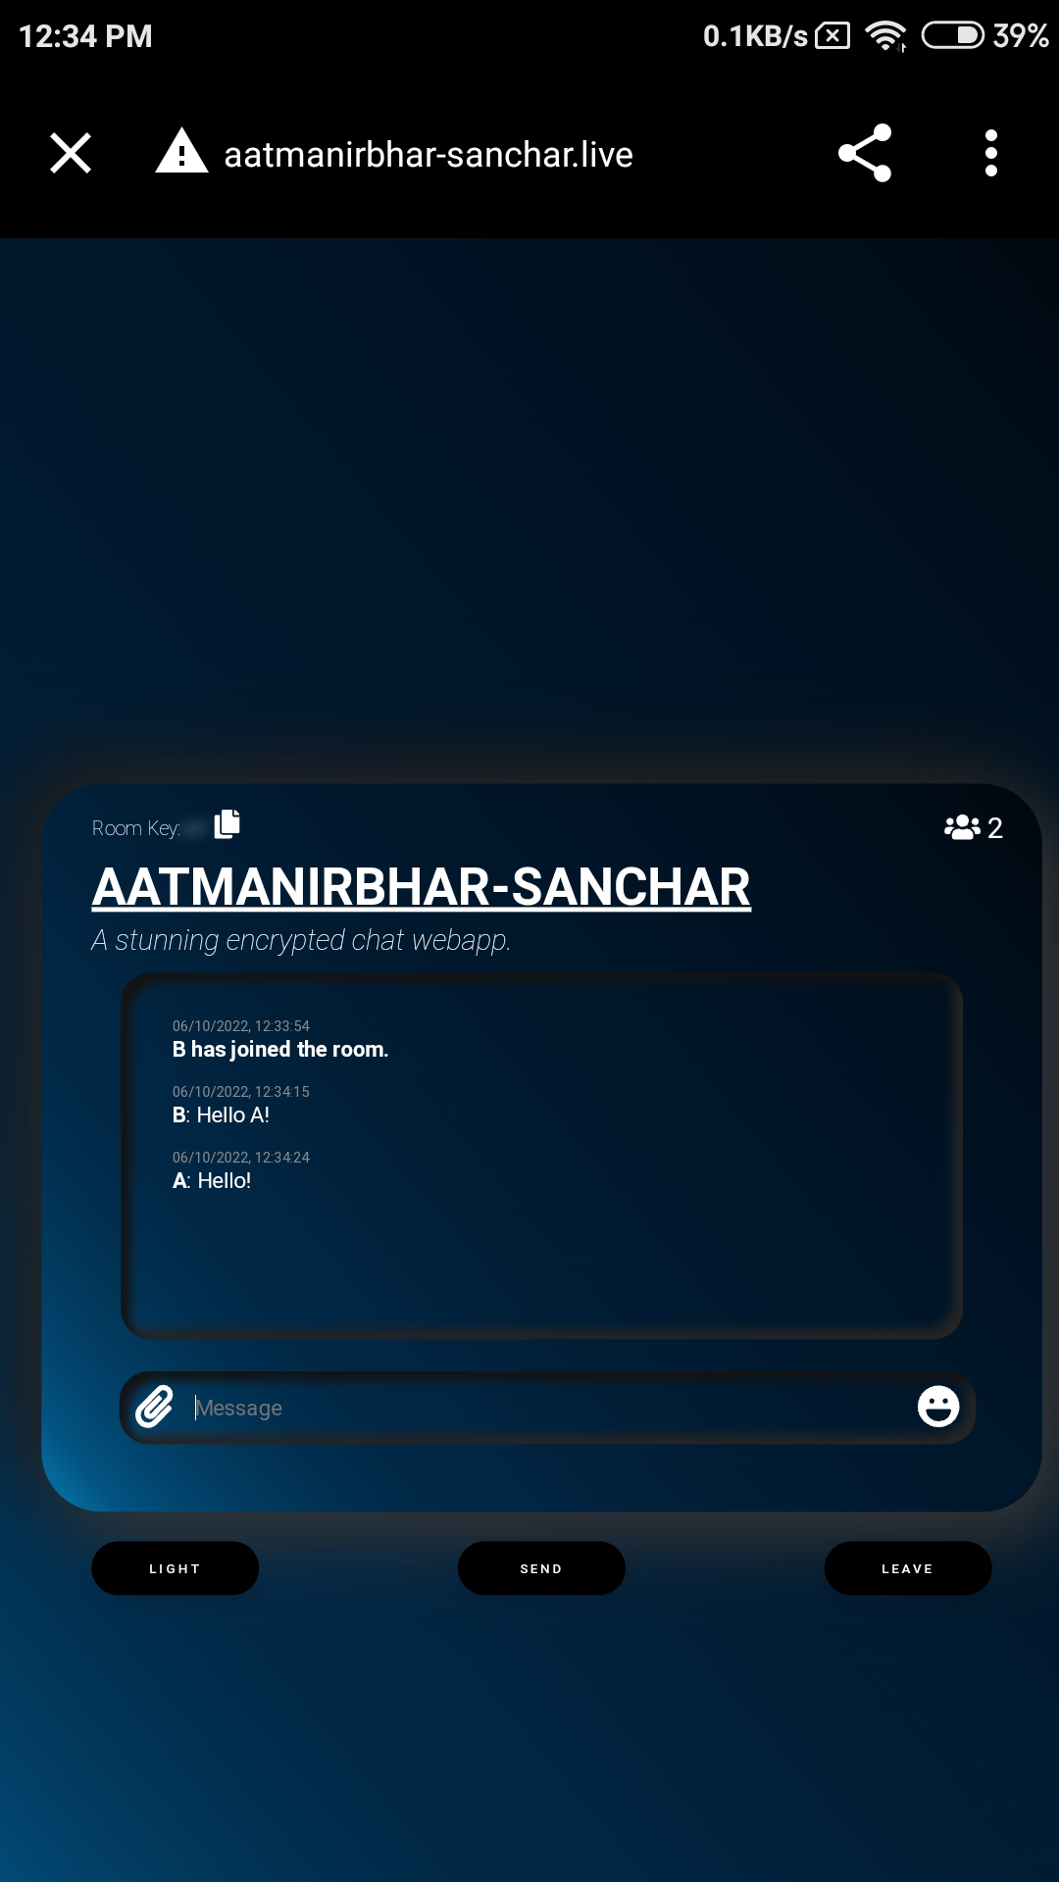
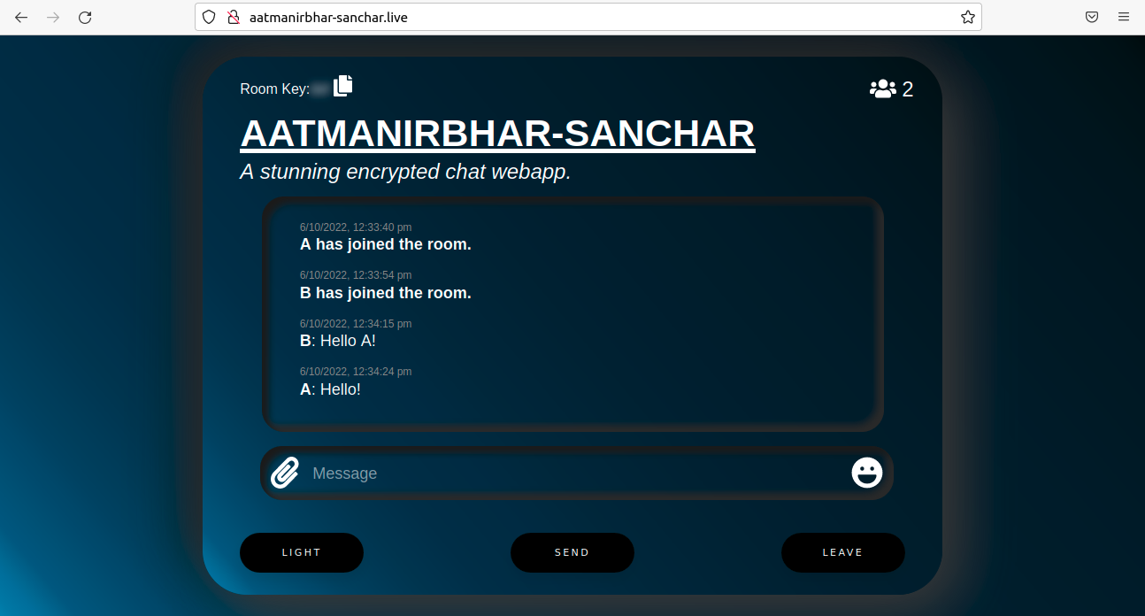
Testing the application
Mobile to Desktop & Desktop to Mobile

Slide 11
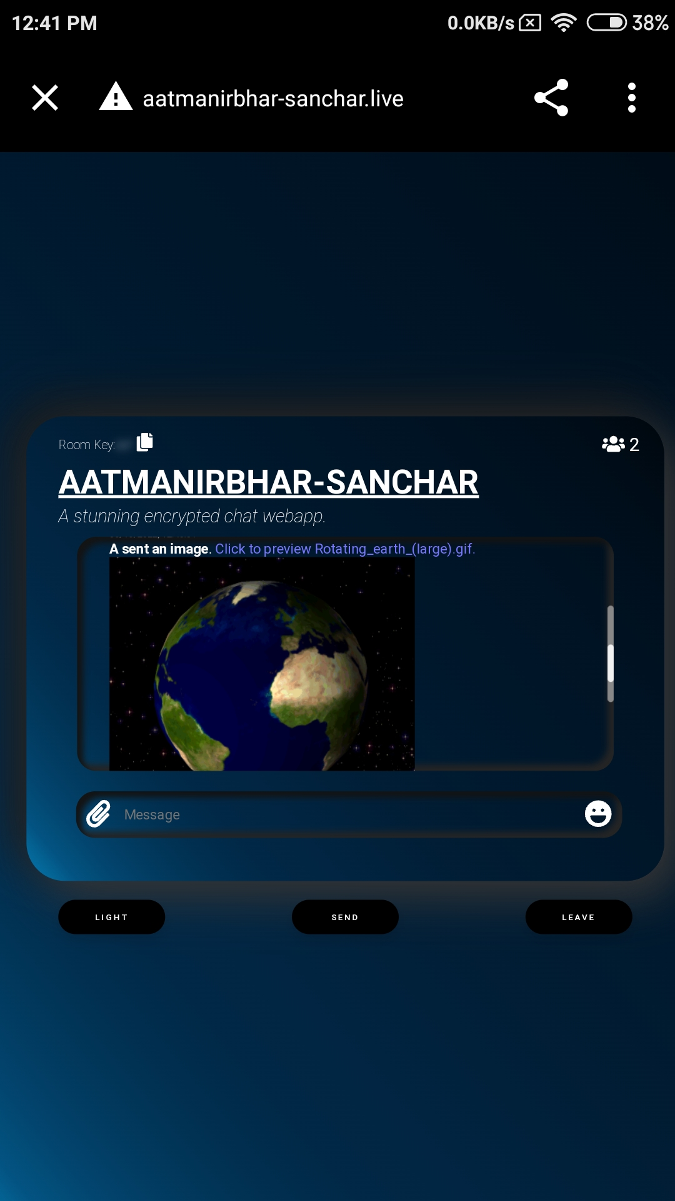
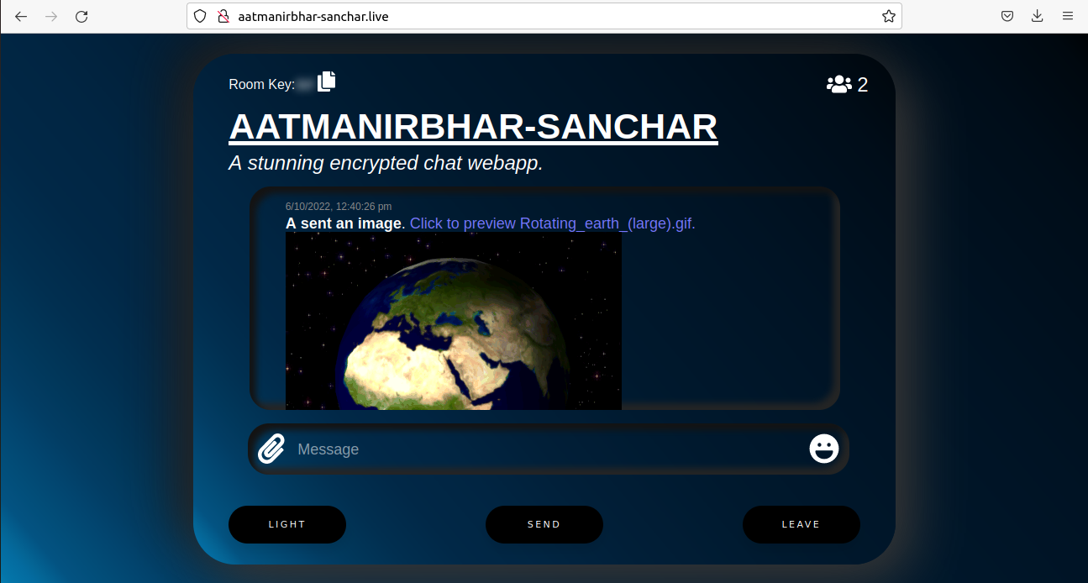
Testing the application

Slide 12
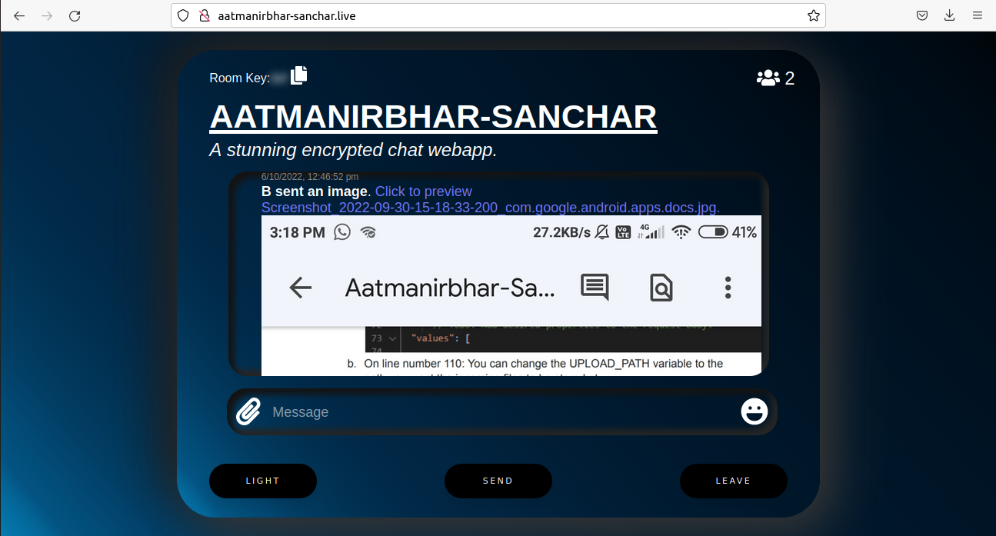
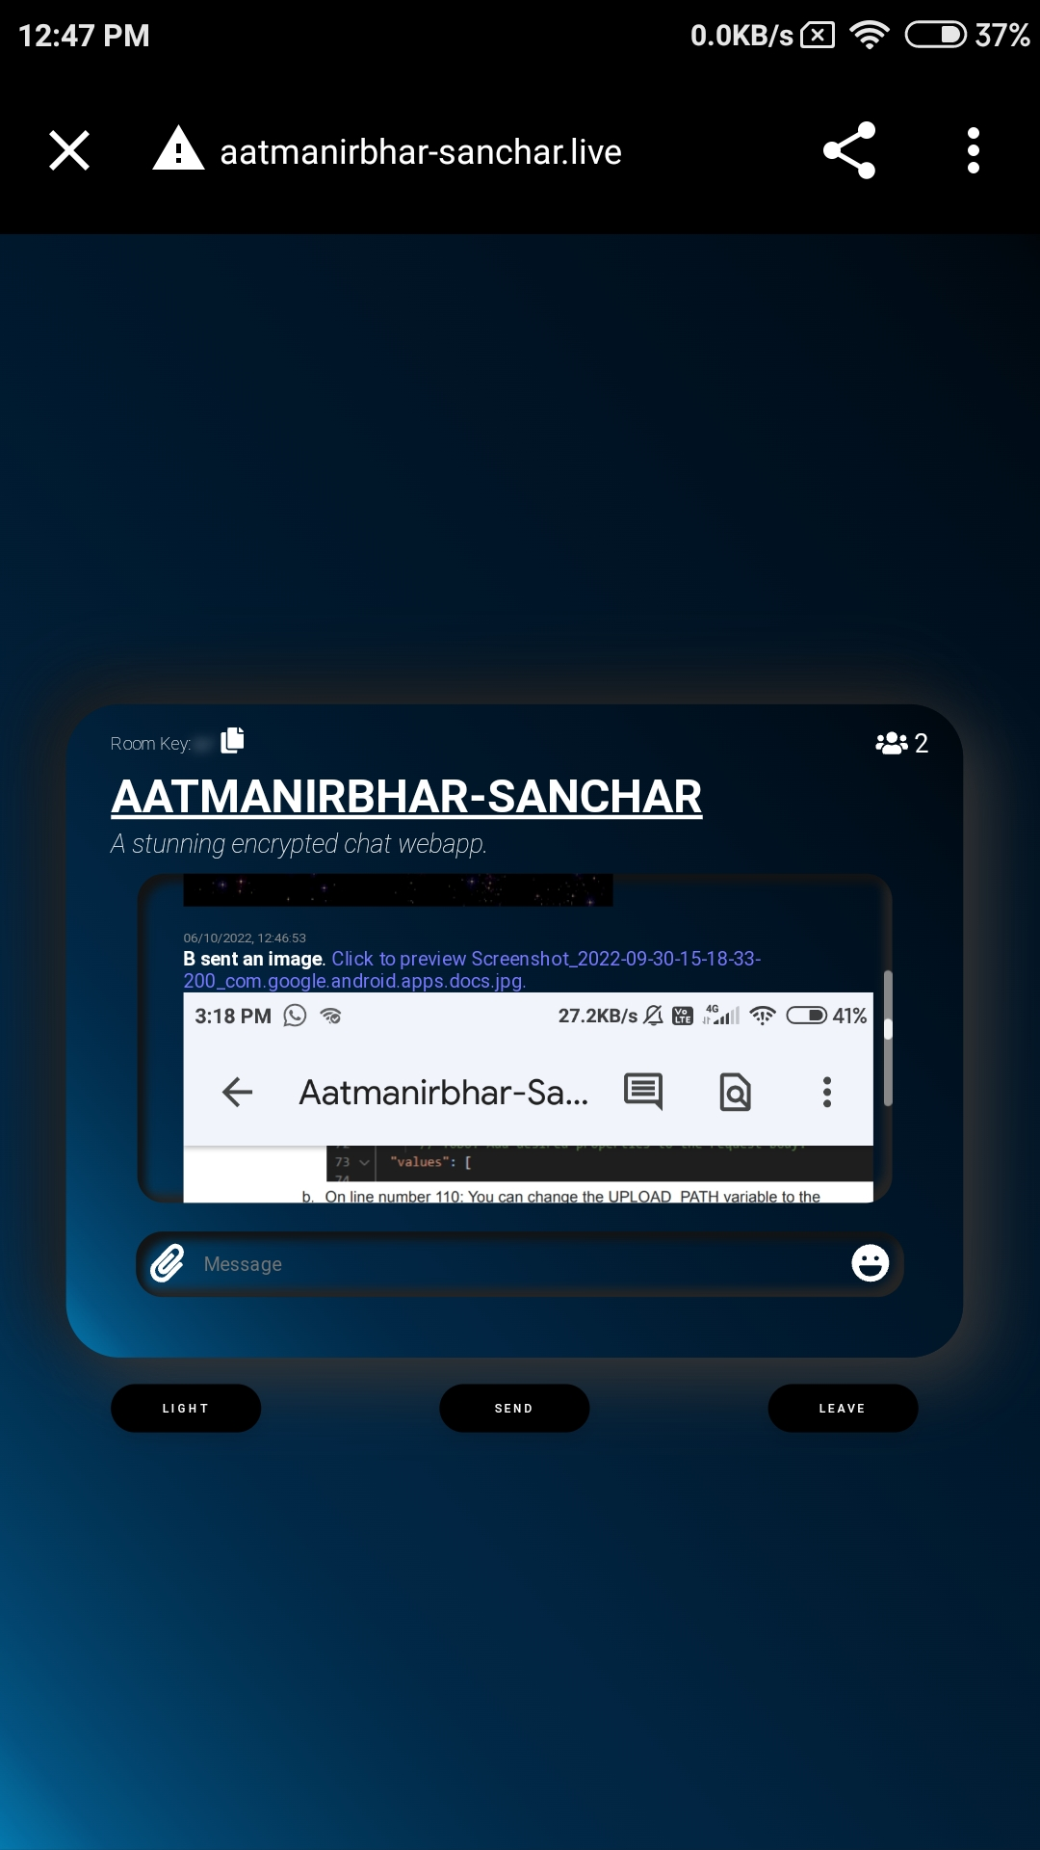
Testing the application

Slide 13
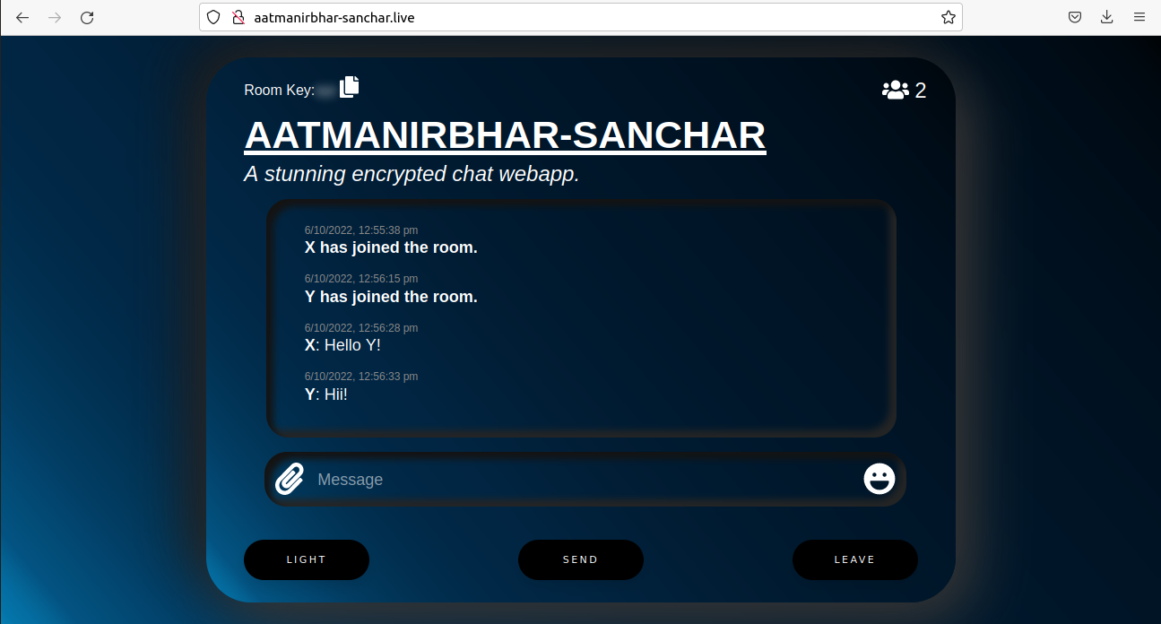
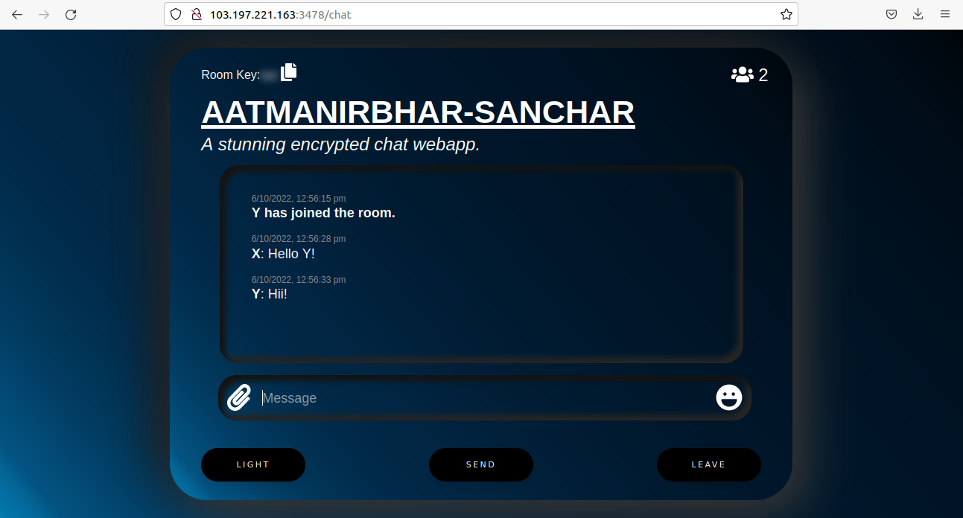
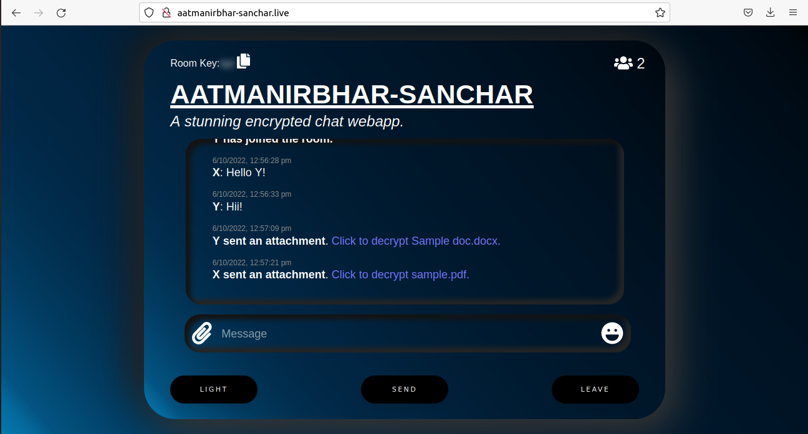

Testing the application
Desktop to Desktop

Slide 14
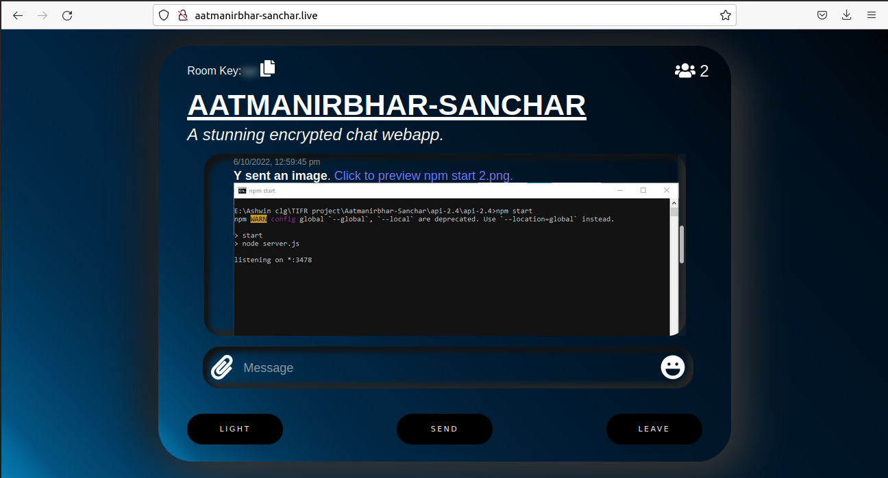
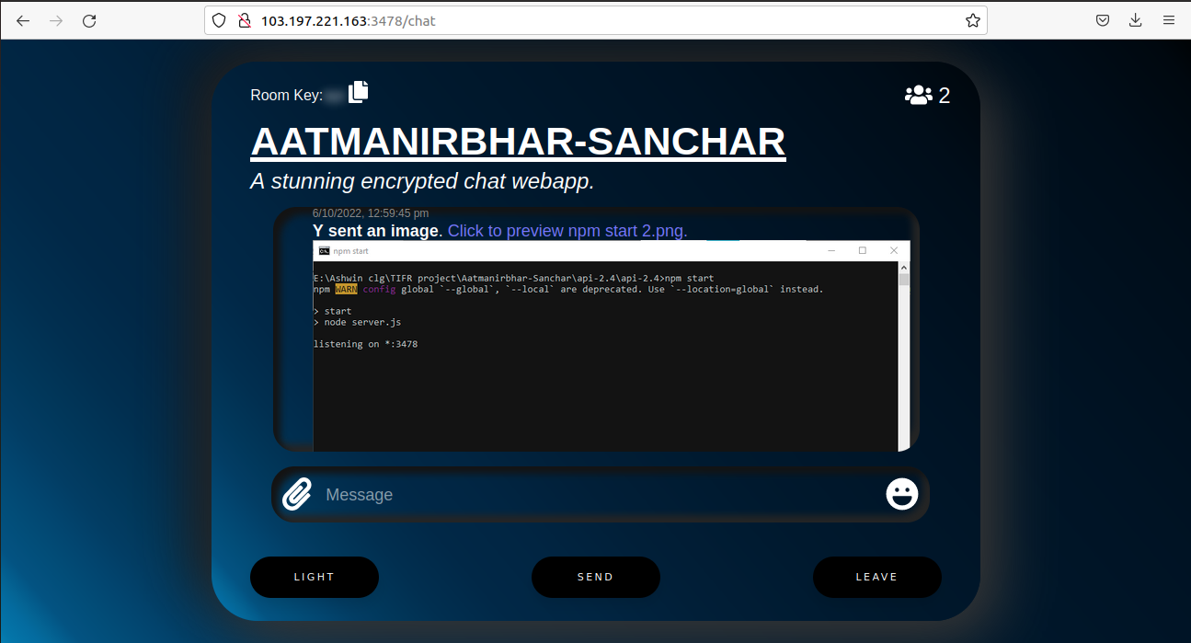
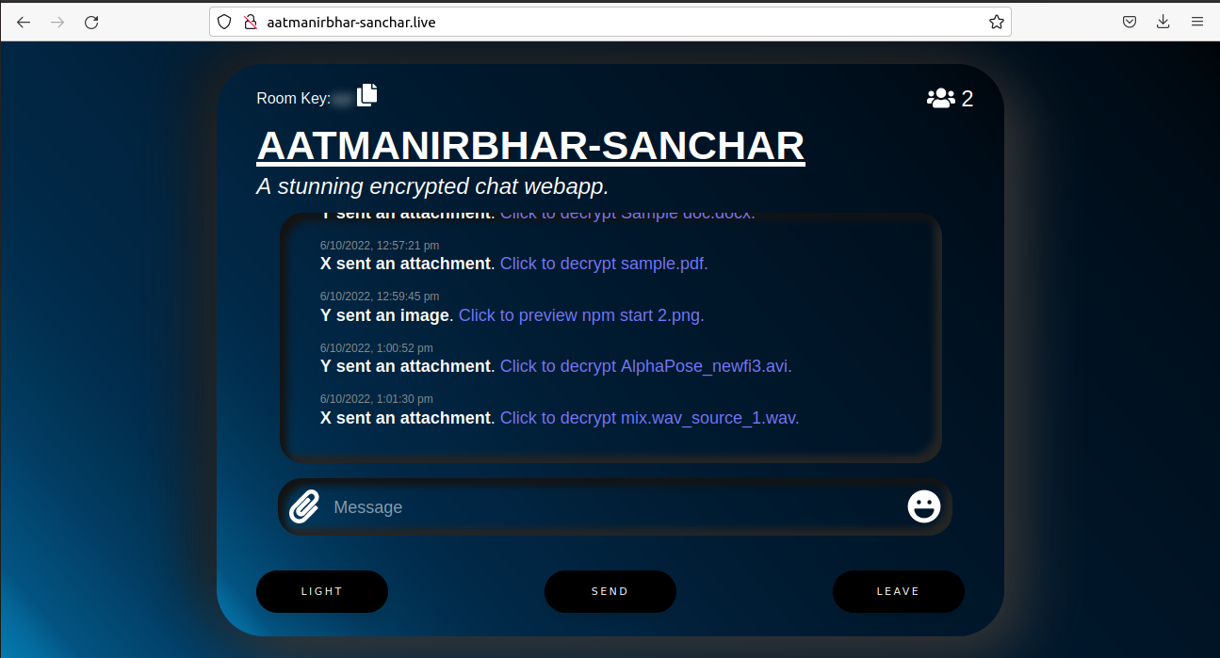
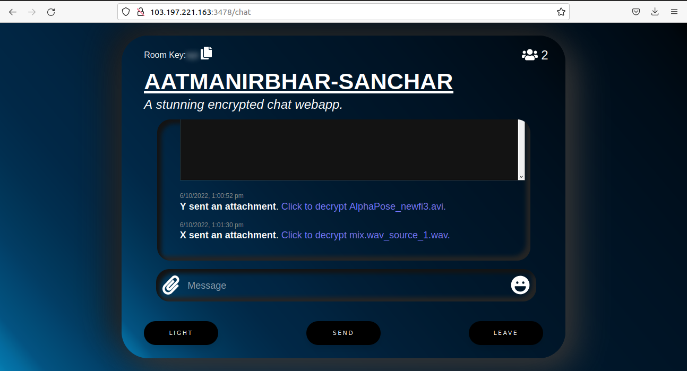
Testing the application

Slide 15
Solving Cookbook installation error
Error while building the Mobile app in Android Studio
Error: The minCompileSdk (<version>) specified in a dependency's AAR metadata (META-INF/com/android/build/gradle/aar-metadata.properties) is greater than this module's compileSdkVersion
Solution: Set both compileSdkVersion and targetSdkVersion to <version> in your build.gradle(app) file.

Slide 16
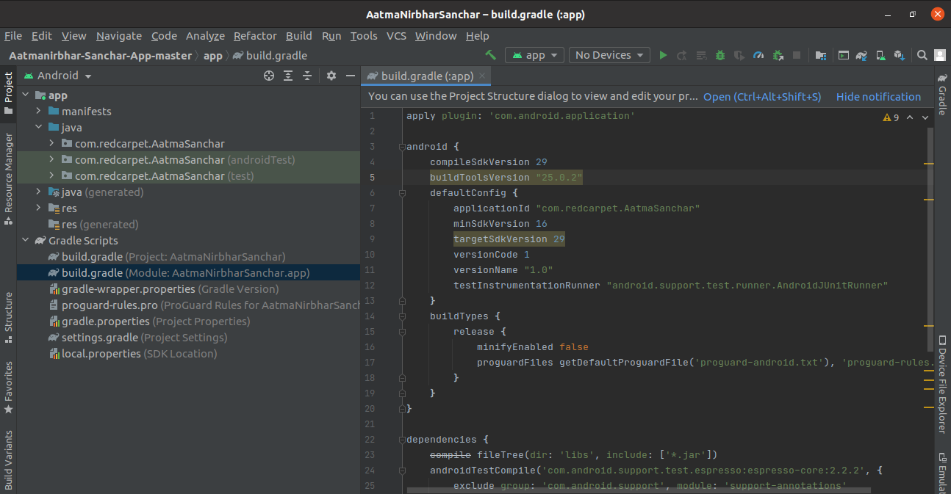
Solving Cookbook installation error

Slide 17
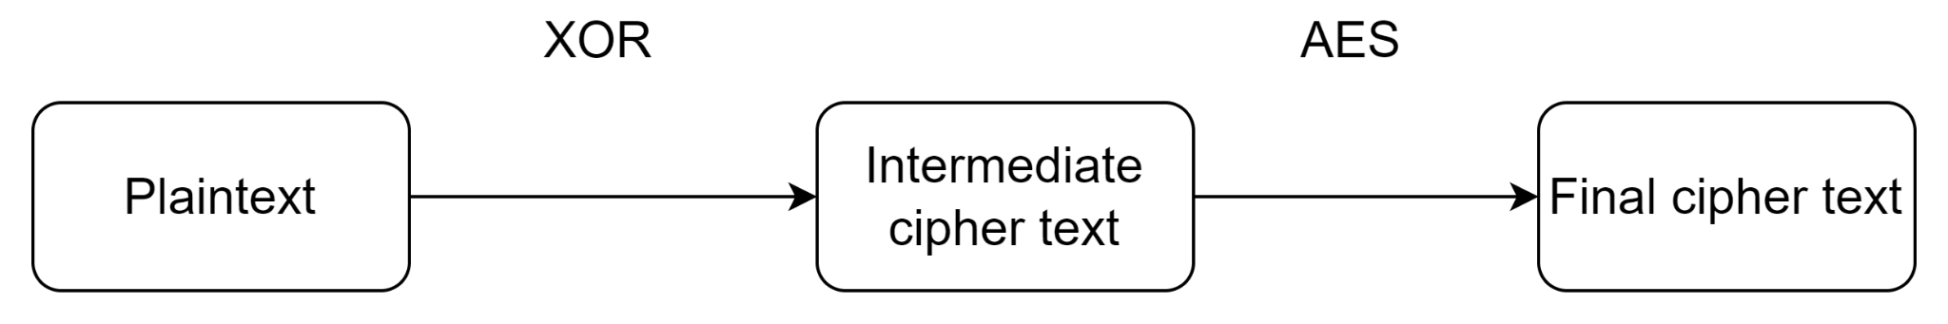
Evaluation of existing Encryption Algorithm
Study and Evaluation of all the encryption techniques employed in the existing project was done
Encryption algorithms in existing System: Two layer encryption Algorithm
First layer employed - XOR algorithm
Second layer was AES Algorithm

Slide 18
Existing System - First Layer (XOR)
The concept of implementation is to first define XOR – encryption key and then to perform XOR operation of the characters in the String with this key which you want to encrypt.
To decrypt the encrypted characters we have to perform XOR operation again with the defined key.
Example, if the binary format of plain text is 11001011 and binary format of the key is 10110001, then the cipher will be as follows:
Plain 1 1 0 0 1 0 1 1
Key 1 0 1 1 0 0 0 1
XOR Encryption
Cipher 0 1 1 1 1 0 1 0

Slide 19

Replacement of First layer - XOR
Modification of the encryption algorithm - Replaced XOR First Layer algorithm with the Hill Cipher algorithm which has a more complex working than the previous method, thus enabling the system to be more efficient
A double layered encryption process is used for achieving enhanced security.
The first layer constitutes of the hill cipher encryption using the room key.
This encryption layer is followed by the Advanced Encryption Standard (AES) algorithm to ensure privacy.

Slide 20
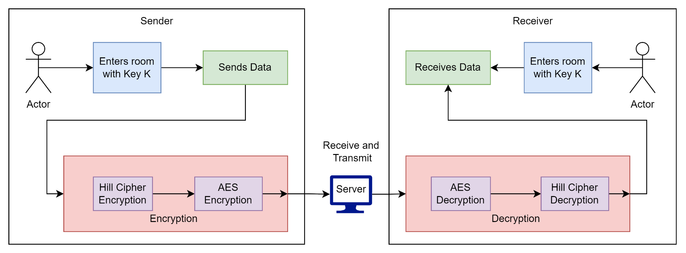
New Methodology Employed

Slide 21
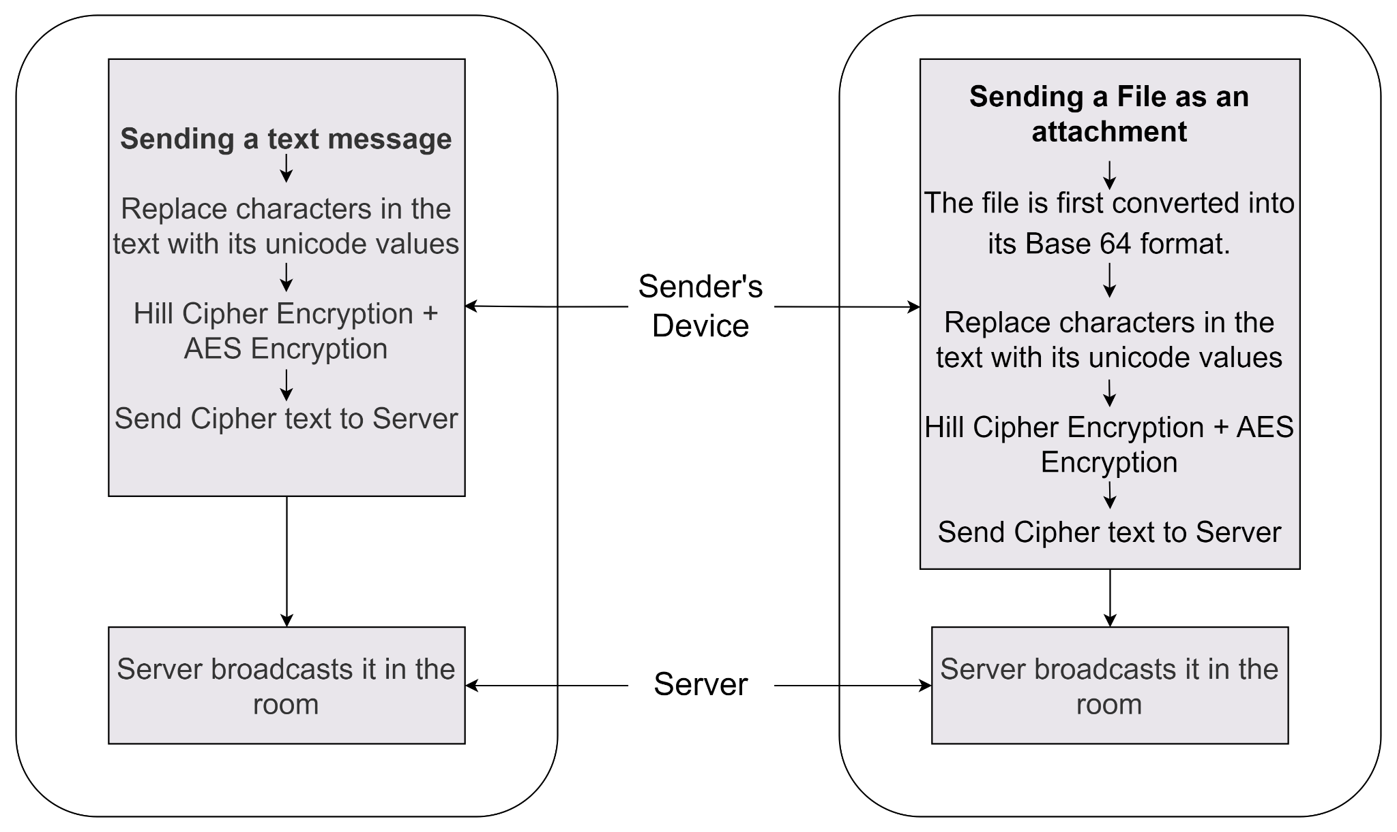
Methodology - Transmitting Message

Slide 22
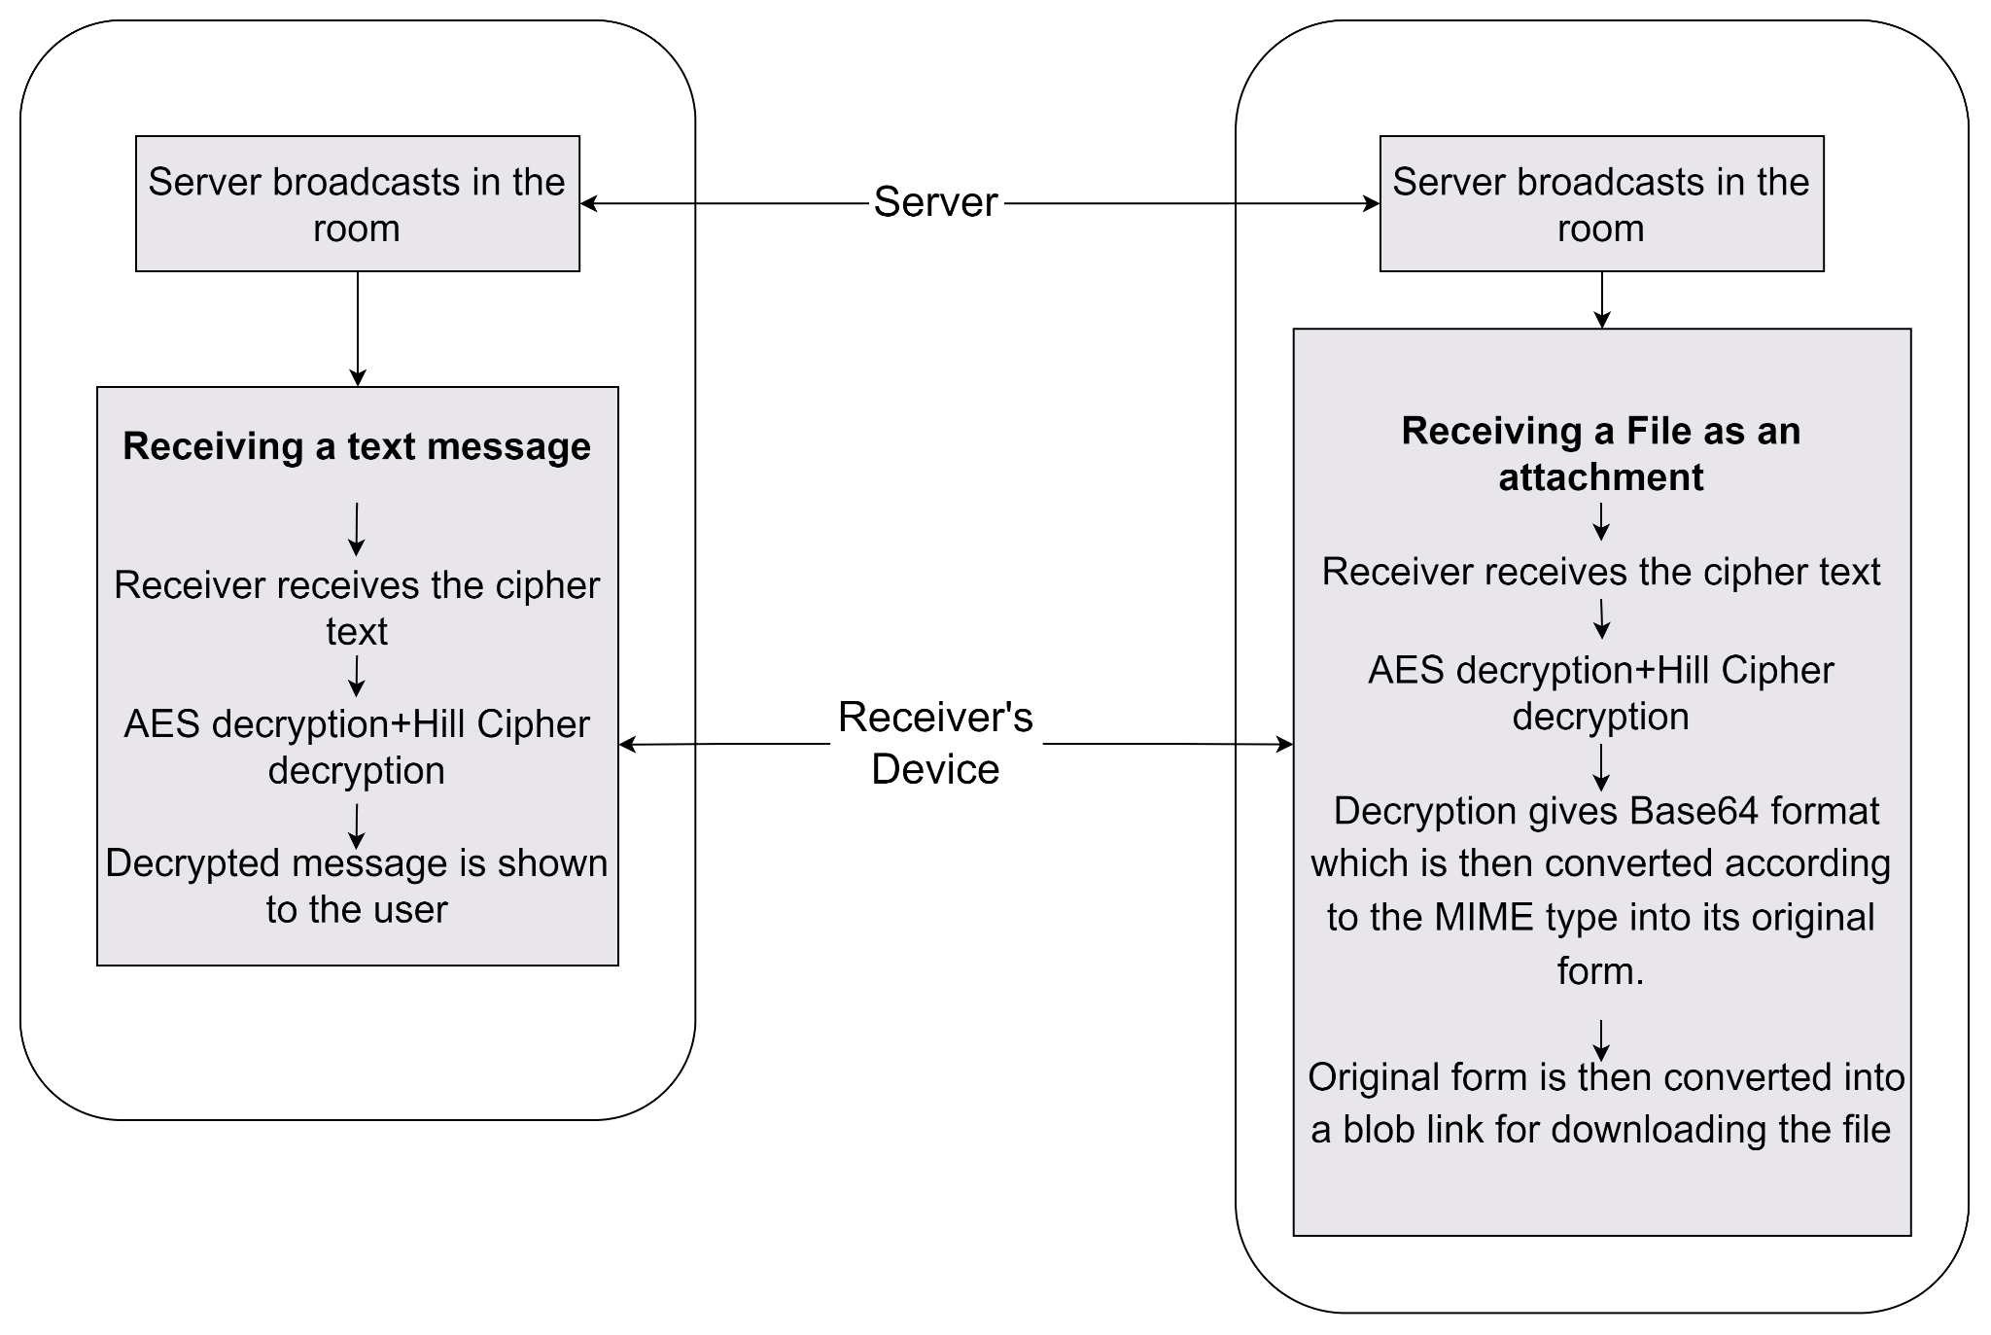
Methodology - Receiving Message

Slide 23
Encryption Methodology

Slide 24
First Layer Encryption - Hill Cipher Algorithm
Encryption:
The message is divided into blocks of size 3
Every character in the plaintext message is replaced by its Unicode value which will be a number between (0-65535)
Organize the plaintext message as a matrix of numbers based on the above conversion.
Now, the plaintext matrix is multiplied by the key matrix
Each element of the resultant matrix is padded with leading zeros such that the total length of each element is 11 to make the result uniform and easier for decryption
Each element is then joined to form a string which will be the cipher text

Slide 25
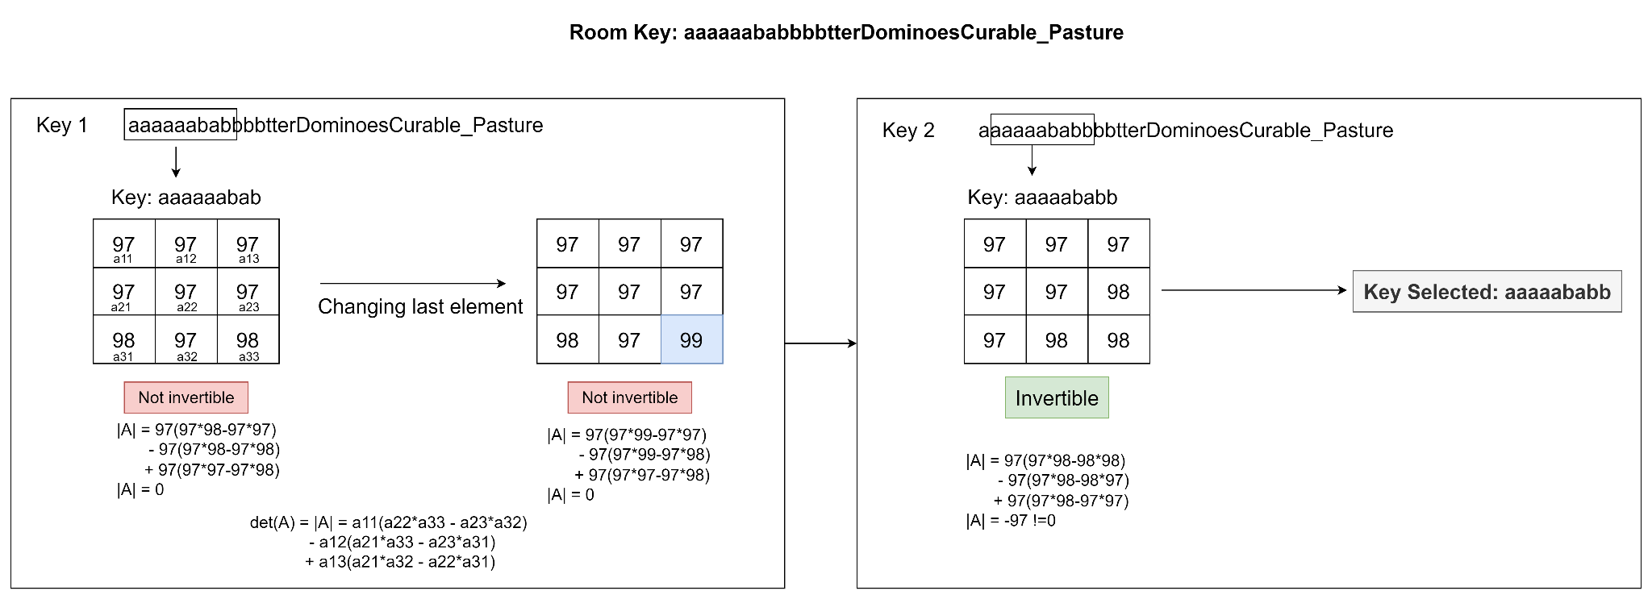
First Layer Encryption - Hill Cipher Algorithm

Slide 26
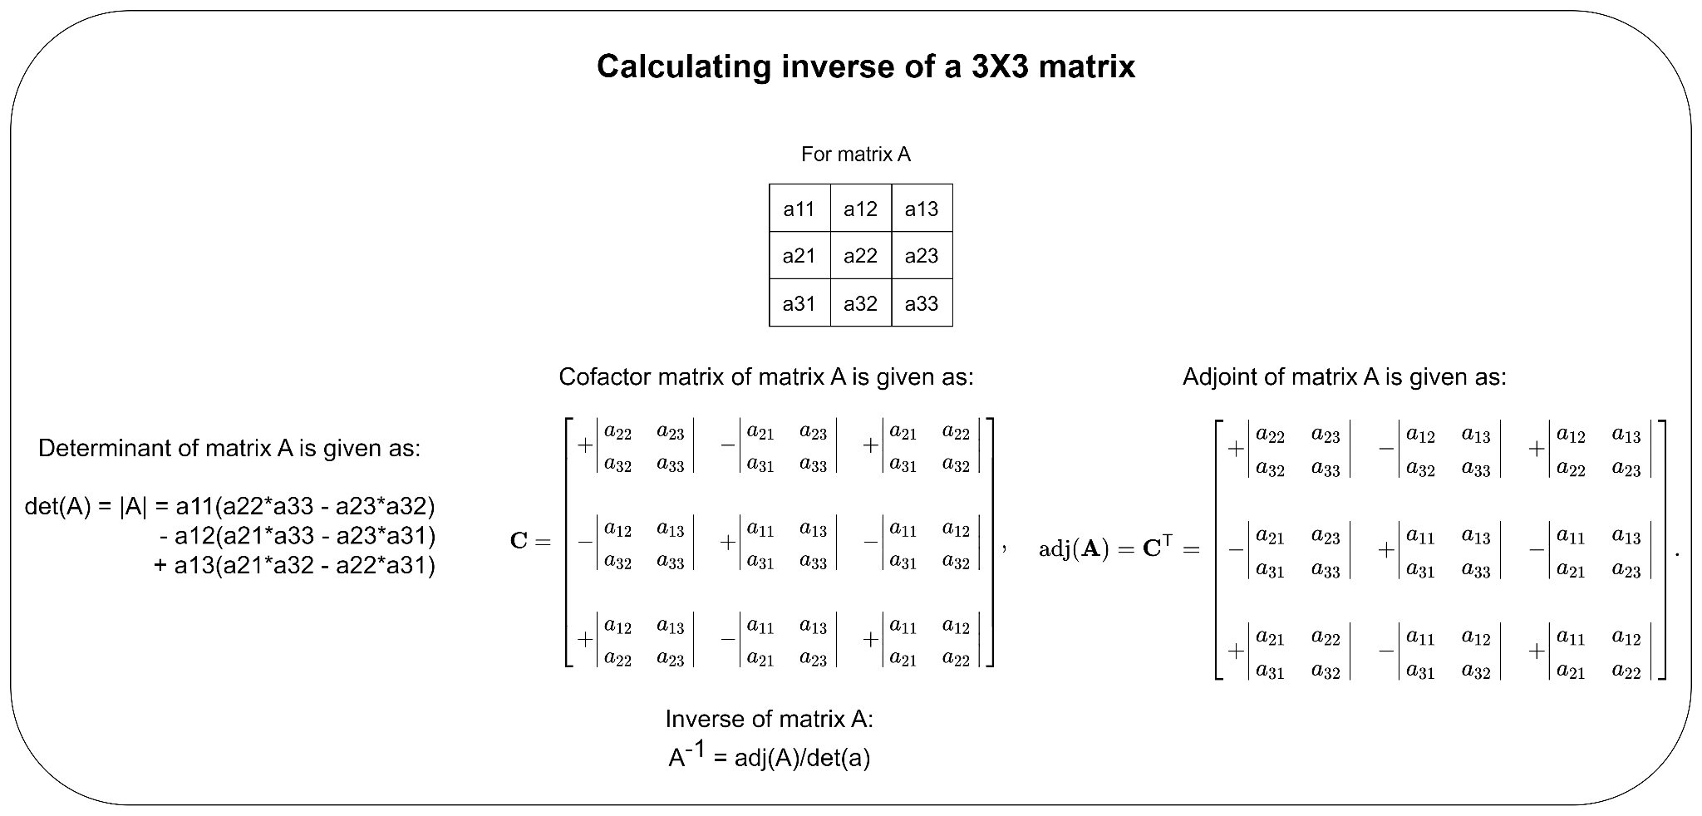
First Layer Encryption - Hill Cipher Algorithm

Slide 27
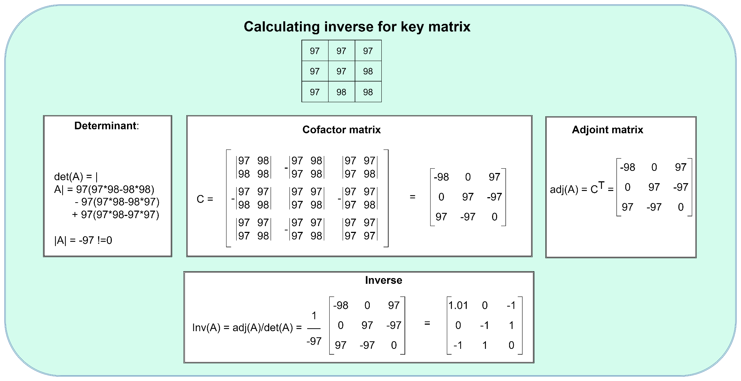
First Layer Encryption - Hill Cipher Algorithm

Slide 28
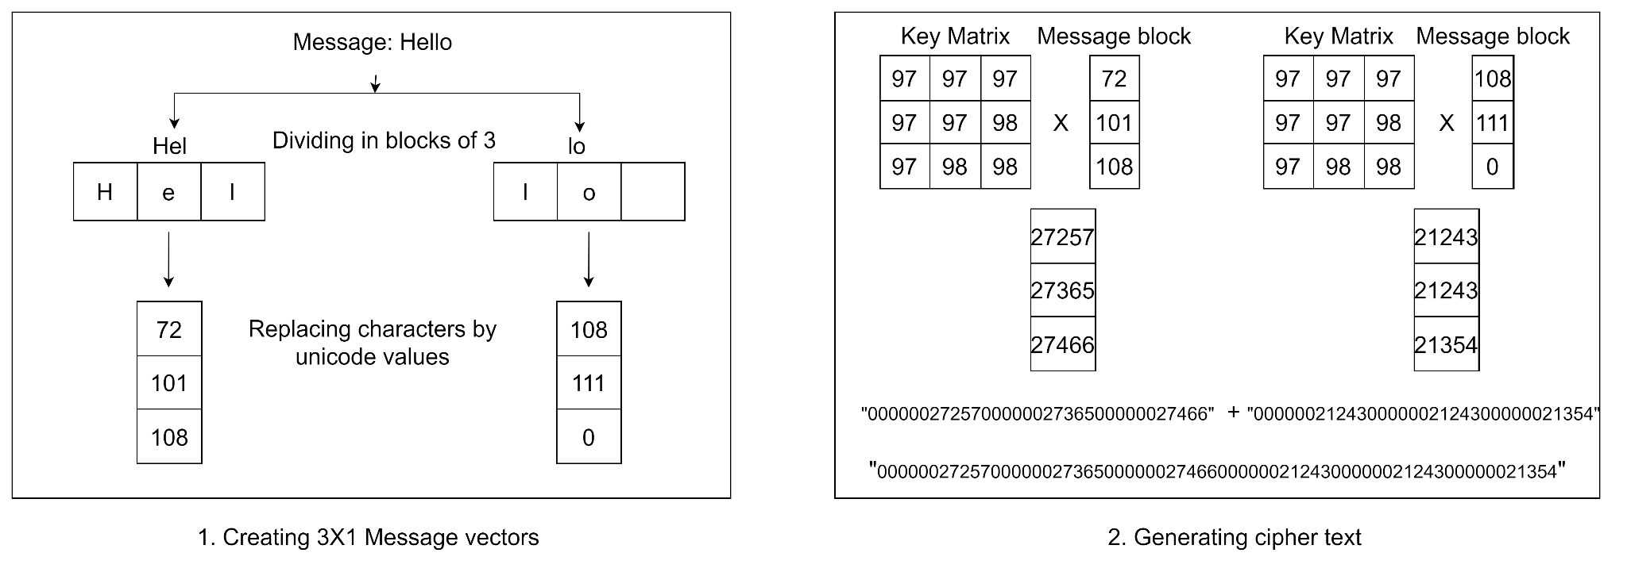
First Layer Encryption - Hill Cipher Algorithm

Slide 29
Issue - First Layer Encryption - Hill Cipher
The double layered encryption was generating a large cipher text. 1MB of data was generating a cipher text approximately of size 40MB. Due to this the transmission time was also affected
The encryption step was appending zeros to text to make the cipher text of each character in the message to 11 characters so that it is a uniform pattern which can later be decrypted.
Instead of the above method we are now inserting only a single ‘+’ character in between the ciphers of each character of the message
With this change the 1MB of data which was generating ~40MB cipher text now generates ~10MB cipher text.

Slide 30
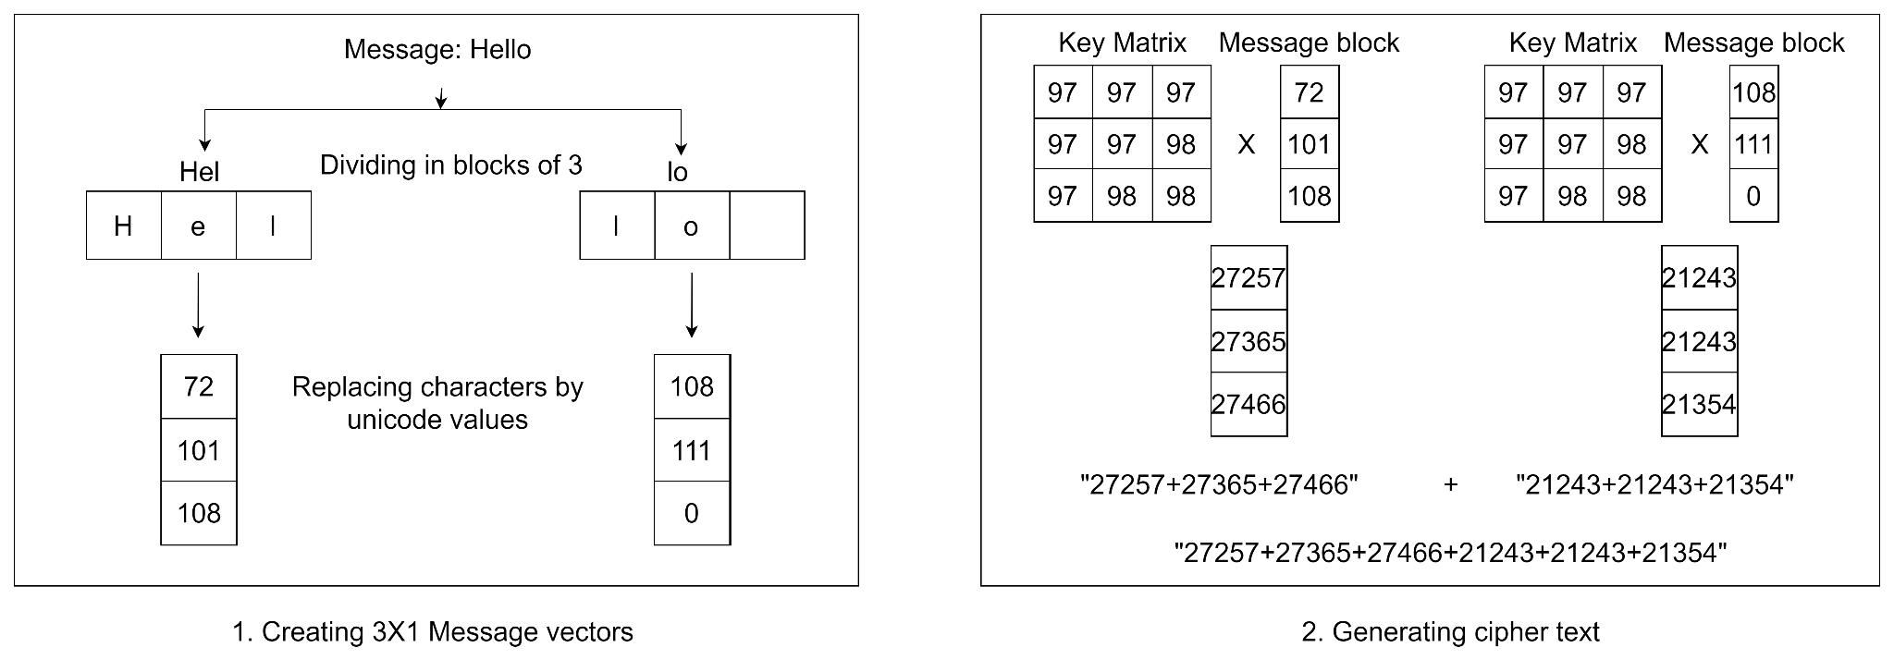
First Layer Encryption - Hill Cipher updated
Replacing “Zeros” with “+”

Slide 31
Second Layer Encryption - AES Algorithm
AES stands for Advanced Encryption Standard. It is a widely used encryption algorithm that is used to protect sensitive data
It uses a symmetric key encryption method, which means that the same key is used for both encrypting and decrypting data.
It is also used in a wide range of applications, including software and hardware encryption, virtual private networks (VPNs), and secure messaging applications.

Slide 32
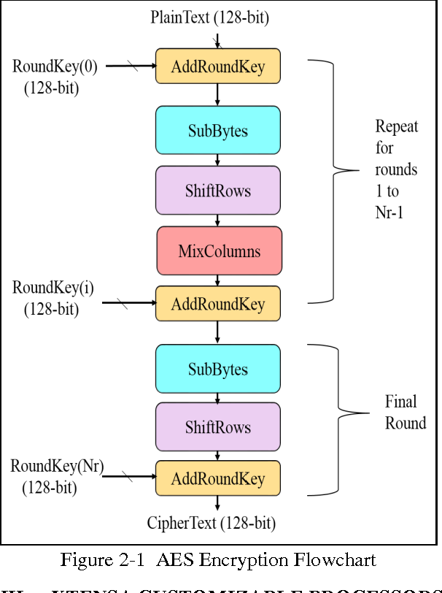
Second Layer Encryption - AES Algorithm
GENERIC FLOWCHART

Slide 33
Second Layer Encryption - AES Algorithm
Key Expansion:
The first step is to expand the given encryption key into a set of round keys. These round keys are used in each round of the AES encryption process.
The key expansion process involves applying key scheduling algorithms to generate a series of round keys.
For AES-128, we will generate 11 round keys, each of 128 bits.
Example:
Plaintext - "27257+27365+27466+21243+21243+21354"
Encryption and Decryption Key - aaaaaababbbbtterDominoesCurable_Pasture

Slide 34
Second Layer Encryption - AES (128 bits)
Round 0 Key: 61706161616162616262626274746572 (Converting aaaaaababbbbtterDominoesCurable_Pasture to hexadecimal and taking the first 128 bits)
Round 1 Key: 54ef3e4f5df1a0a867cbf3f57b124bbd
Round 2 Key: d94ca3d1d4b261f5b2db43423fb0349c
Round 3 Key: 1c9cb3a20c00db08b7f481dc31e8f8ef
Round 4 Key: 24ff10d1a31b5d98175d8e1ac48ca2eb
Round 5 Key: 396d7e0b931f3d925d79a7e6e490e04a
Round 6 Key: d96d4e2b9f8d74a44f1f7bdc5b6d8330
Round 7 Key: 71b971c02a9cfbc3e87ca8cb5f99e26b
Round 8 Key: 4a3e02868a382cc7c1e21c59b961d7f7
Round 9 Key: 6d5ad4a3dada656bed7f3dbfde89768a
Round 10 Key: 3dc1fc5c104a1998911f1011a18b9262

Slide 35
Second Layer Encryption - AES (128 bits)
2. Initial Round:
In the initial round of AES encryption, the plaintext is XORed with the first round key.
Example:
For the given plaintext "27257+27365+27466+21243+21243+21354," we treat each character as a 16-bit block and convert it to hexadecimal representation:
Plaintext: 32373235372b32373336352b32373436362b32313234332b32313234332b3231333534
This plaintext is divided into blocks of 128 bits each
Plaintext Block 1: 32373235372b32373336352b32373436
Plaintext Block 2: 362b32313234332b32313234332b3231
Plaintext Block 3: 33353400000000000000000000000000 (padding with null characters)
⊕
Round 0 Key: 61706161616162616262626274746572
XOR Result: 90959E64D88C0F9DDEE60D58C3B932B08922B88E8A59564F

Slide 36
Second Layer Encryption - AES (128 bits)
2. Initial Round:
In the initial round of AES encryption, the plaintext is XORed with the first round key.
Each plaintext block is then XORed with the round key
Plaintext Block 1: 32373235372b32373336352b32373436
Plaintext Block 2: 362b32313234332b32313234332b3231
Plaintext Block 3: 33353400000000000000000000000000 (padding with null characters)
⊕
Round 0 Key: 61706161616162616262626274746572
XOR Result: 90959E64D88C0F9DDEE60D58C3B932B0

Slide 37
Second Layer Encryption - AES (128 bits)
3. Main Round:
AES Main Round Encryption Steps:
After the initial stage, the XOR result will be arranged in a 4x4 matrix format, the following steps will be repeated 10 times with different round keys. First iteration is explained: (Working shown only for first 16 bits of the key)
90 95 9E 64
D8 8C 0F 9D
DE E6 0D 58
C3 B9 32 B0
SubBytes:
In this step, each byte of the state matrix (a 4x4 array) is replaced by a corresponding byte from the S-box (substitution box), a fixed table used for substitution.
Substitution is done independently for each byte.
SubBytes:
B3 94 49 1F
5D 3D 85 6D
7F 75 2F 0F
98 21 98 B8

Slide 38
Second Layer Encryption - AES (128 bits)
3. Main Round:
AES Main Round Encryption Steps:
2. ShiftRows:
In this step, the rows of the state matrix are shifted cyclically.
The first row remains unchanged.
The second row is shifted one position to the left.
The third row is shifted two positions to the left.
The fourth row is shifted three positions to the left.
B3 94 49 1F
5D 3D 85 6D
7F 75 2F 0F
98 21 98 B8
ShiftRows:
B3 94 49 1F 3D 85 6D 5D 2F 0F 7F 75 B8 98 21 98

Slide 39
Second Layer Encryption - AES (128 bits)
3. Main Round:
AES Main Round Encryption Steps:
3. MixColumns:
In this step, each column of the state matrix is mixed using a matrix multiplication operation.
This step provides diffusion and ensures that the output depends on every input byte.
MixColumns:
B3 3D 2F B8
7D 75 98 1F
2F 21 49 0F
98 94 85 6D

Slide 40
Second Layer Encryption - AES (128 bits)
3. Main Round:
AES Main Round Encryption Steps:
4. AddRoundKey:
In this step, a round key is XORed with the state matrix.
The round key used in each main round is derived from the key expansion process.
Since this example is for round-1, we will use round key -1.
STATE MATRIX
90 95 9E 64
⊕ D8 8C 0F 9D
DE E6 0D 58
C3 B9 32 B0
RESULT:
B3 03 D7 B8
60 7D 90 0E
BA 22 71 8F
FA 9D E1 0D
ROUND KEY-1
54ef3e4f5df1a0a867cbf3f57b124bbd

Slide 41
Second Layer Encryption - AES (128 bits)
4. Final Round:
After the first iteration, the next 4x4 matrix will be generated which serves as the state matrix or the start matrix for the next round.
Then the 4 steps are performed again from iteration 2 - iteration 9 which is included in the main round.
The final round i.e iteration 10 is similar to the main rounds but omits the MixColumns stage, leaving only SubBytes, ShiftRows, and AddRoundKey.
This step ensures that the decryption process can be easily reversed.
The resulting ciphertext after the main rounds of AES-128 encryption is:
0A 43 5B B9
00 FC 0B 2A
33 A4 9D B6
50 68 30 96
Round-9 Cipher Matrix Final Cipher Matrix
30 23 27 32
28 19 C5 44
32 E8 14 D1
7A E2 13 0B

Slide 42
Decryption Methodology

Slide 43
Decryption Methodology - AES (128 bits)
Key Expansion:
For the decryption of the cipher text, the first step is the Key Expansion step, which is the same as used in encryption
The only difference is that the order of the usage of round keys are now reversed, hence first round key 10 will be used and eventually followed by 9,8,7...
Round 10 Key: 3dc1fc5c104a1998911f1011a18b9262
Round 9 Key: 6d5ad4a3dada656bed7f3dbfde89768a
Round 8 Key: 4a3e02868a382cc7c1e21c59b961d7f7
Round 7 Key: 71b971c02a9cfbc3e87ca8cb5f99e26b
Round 6 Key: d96d4e2b9f8d74a44f1f7bdc5b6d8330
Round 5 Key: 396d7e0b931f3d925d79a7e6e490e04a
Round 4 Key: 24ff10d1a31b5d98175d8e1ac48ca2eb
Round 3 Key: 1c9cb3a20c00db08b7f481dc31e8f8ef
Round 2 Key: d94ca3d1d4b261f5b2db43423fb0349c
Round 1 Key: 54ef3e4f5df1a0a867cbf3f57b124bbd

Slide 44
Decryption Methodology - AES (128 bits)
2. Final Round (Inverse AddRoundKey):
In the initial round of AES encryption, the plaintext is XORed with the first round key.
Ciphertext: 0A 43 5B B9 00 FC 0B 2A 33 A4 9D B6 50 68 30 96
⊕
Round 10 Key (Decryption): 3dc1fc5c104a1998911f1011a18b9262
Result after XOR: 30 23 27 32 28 19 C5 44 32 E8 14 D1 7A E2 13 0B

Slide 45
Decryption Methodology - AES (128 bits)
3. Main Round:
After the initial stage, the XOR result will be arranged in a 4x4 matrix format, the following steps will be repeated 10 times with different round keys. First iteration is explained: (Working shown only for first 16 bits of the key)
We need to perform the inverse of the SubBytes, ShiftRows, MixColumns, and AddRoundKey steps for each round in reverse order.
Example for Round 10 (Decryption):
Inverse AddRoundKey:
In this step, the ciphertext is XORed with the last round key to retrieve the state matrix after the main rounds of encryption.
The final round key used for decryption is the same as the first round key used for encryption.
Matrix generated after Inverse AddRoundKey:
30 23 27 32
28 19 C5 44
32 E8 14 D1
7A E2 13 0B

Slide 46
Decryption Methodology - AES (128 bits)
3. Main Round:
b. Inverse MixColumns:
In this step, the columns of the state matrix are mixed using a fixed inverse mixing matrix through matrix multiplication.
This step provides diffusion and ensures that one byte's change affects multiple bytes in the previous round.
Matrix after Inverse MixColumns:
A4 1F 3F 58
F1 5F 2A 5D
0F 71 D3 25
8E E0 6A 6C

Slide 47
Decryption Methodology - AES (128 bits)
3. Main Round:
c. Inverse ShiftRows:
The rows of the state matrix are cyclically shifted to the right.
The first row remains unchanged.
The second row is shifted one position to the right.
The third row is shifted two positions to the right.
The fourth row is shifted three positions to the right. This step undoes the effect of the ShiftRows step in encryption.
Matrix after Inverse ShiftRows:
A4 5F D3 6C
5D F1 5F 2A
D3 25 0F 71
E0 6A 6C 8E
A4 1F 3F 58
F1 5F 2A 5D
0F 71 D3 25
8E E0 6A 6C

Slide 48
Decryption Methodology - AES (128 bits)
3. Main Round:
d. Inverse SubBytes:
In this step, each byte of the state matrix is replaced with a corresponding byte from the inverse S-box, a fixed substitution table used in decryption.
The inverse S-box is designed to reverse the effect of the S-box used in encryption.
The main rounds are performed in reverse order from the last round to the first round.
Matrix after Inverse SubBytes:
4F C4 0D E8
CA 5E 72 3B
4D 46 91 5B
8A 7A 0A 29

Slide 49
Decryption Methodology - AES (128 bits)
4. Initial Round:
After the 9 iterations of main rounds, we have the state matrix after the initial round of encryption.
In the initial round of AES encryption, the plaintext is XORed with the first round key.
For decryption, we perform the inverse operation and XOR the state matrix with the first round key to obtain the original plaintext.
The decryption process is now complete, and the obtained plaintext is the same as the original plaintext that was encrypted using AES.
⊕
RESULT AT ROUND 1
(Iteration - 9 till Iteration -1)
D6 1B 24 94
ED 69 5C 8B
B5 39 72 2B
32 5B 2C 1A
ROUND-1 KEY:
54ef3e4f5df1a0a867cbf3f57b124bbd
RESULT
90 95 9E 64
D8 8C 0F 9D
DE E6 0D 58
C3 B9 32 B0

Slide 50
Decryption Methodology - AES (128 bits)
5. Final Step:
In order to obtain our original decrypted plaintext, we take the result from the previous step and then XOR it with the round key - 0, which then yields the hexadecimal representation of our original text.
Round 0 Key: 61706161616162616262626274746572
⊕
Matrix : 90959E64D88C0F9DDEE60D58C3B932B0
Result: 32373235372b32373336352b32373436 + 362b32313234332b32313234332b3231 + 333534
Plaintext - "27257+27365+27466+21243+21243+21354"

Slide 51
Decryption - Hill Cipher Algorithm
Decryption:
The string obtained from the result of AES decryption will be split according to the “+” sign
Blocks of three numbers will form a 3x1 cipher matrix
This cipher matrix is multiplied by the inverse of the key matrix
It will give a 3x1 resultant matrix which will have the Character codes
The char codes will then be replaced by the corresponding characters and the final text will be generated.
This process will be continued for all the blocks and the results will be concatenated

Slide 52
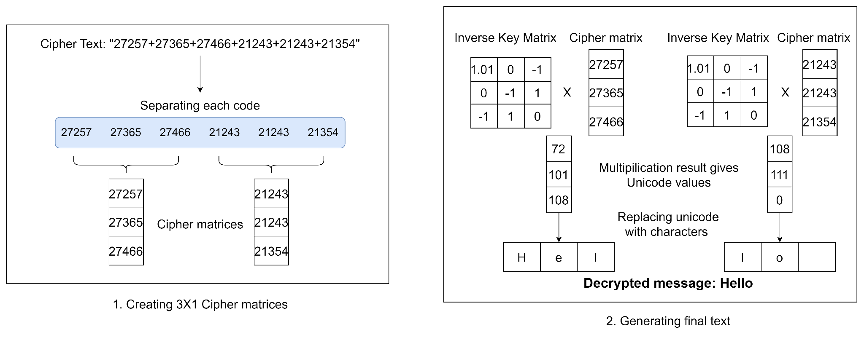
Decryption - Hill Cipher Algorithm
Decryption process

Slide 53
Other Modifications - Automation
Starting the application server required entering manual commands on the server. There was a requirement that the process should be automated
Solution:
A bash script was written which has all the commands required to start the server.
This script was then added to crontab which is a list of tasks scheduled to be run at specific time.
The script runs automatically after the server is turned on and the application can be accessed.

Slide 54
Other Modifications - Status Bar
There was a need for a status bar which shows the status of the message transmission
Solution:
The percentage of data sent to the receiver was calculated by fetching the amount of data in bytes received by the receiver and comparing it with the total size of the data sent in bytes.
This is then displayed along with the message whenever a user sends a file.

Slide 55
Hardware, Software, Tools
Hardware:
PC/Laptop with Ubuntu OS for the server.
A client device and receiver device (Mobile or PC/Laptop with any OS)
Software:
Node Package Manager (npm).
Language: Node JS for Back-end, HTML,CSS,JS for front-end.

Slide 56
Server configuration
Requirements:
OS: Ubuntu 20.04 (Recommended, although will work on any OS supporting python and Node Js)
Network: Require a Static IP Address with an open port.
NPM: Version 6.14.14
NodeJS: Version 14.17.5

Slide 57
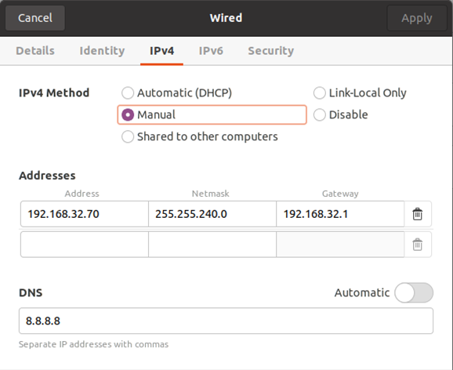
Server configuration
Configuring Static IP address for server
Contact your network admin for an IP address which can be used as a static IP
Go to network settings → As shown in the image go to wired networks
In the IPv4 tab select the method as Manual instead of Automatic(DHCP)
In the addresses section enter the assigned IP address and other details from the network admin
Apply the changes

Slide 58
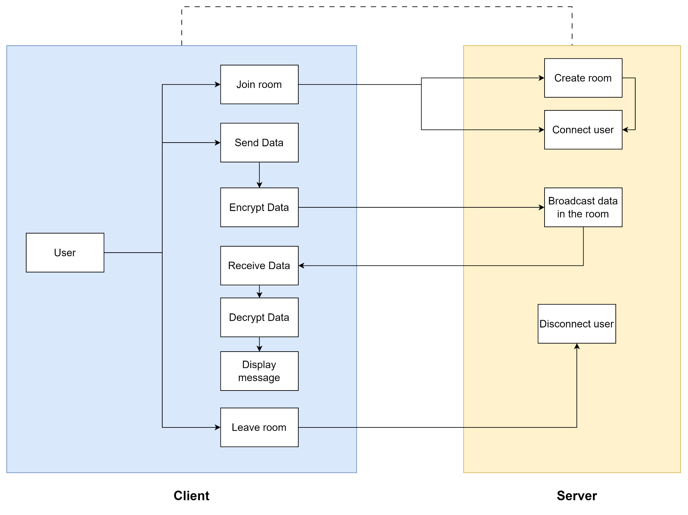
Block Diagram

Slide 59
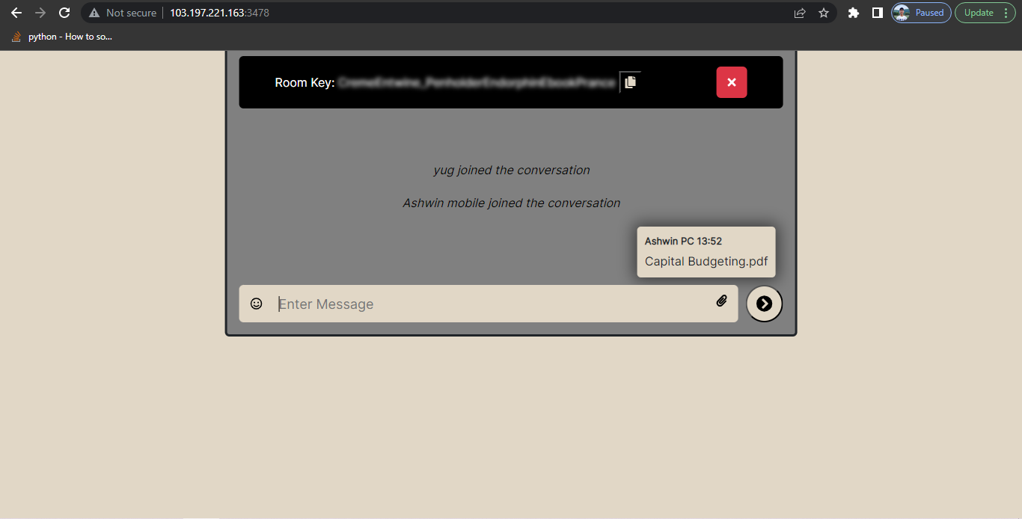
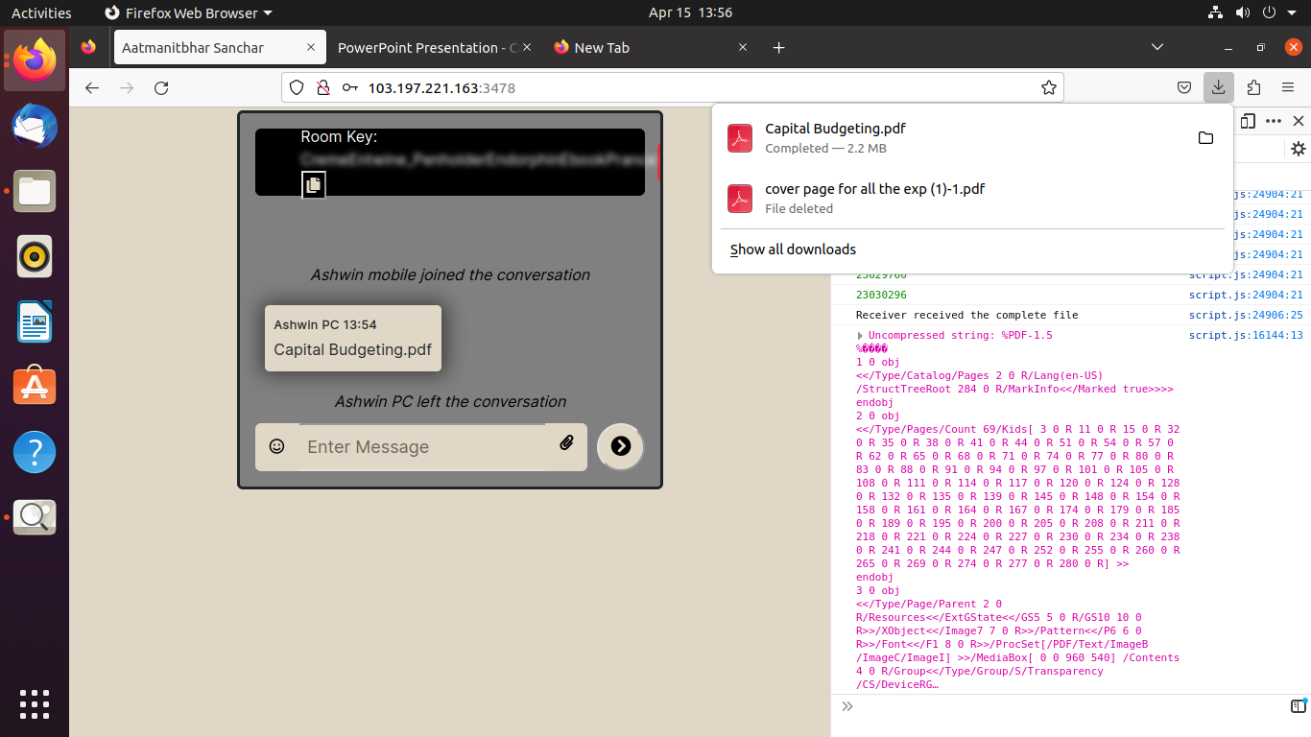
Screenshots: Demonstrating communication
Desktop-Desktop
File size: 2.2MB, type:pdf
Sender
Receiver

Slide 60
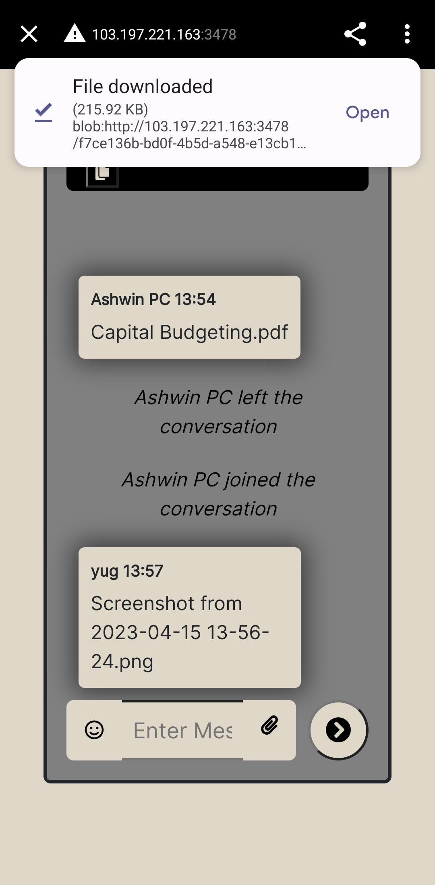
Screenshots
Desktop-Mobile
File size: 2.2MB, type:pdf
Sender
Receiver

Slide 61
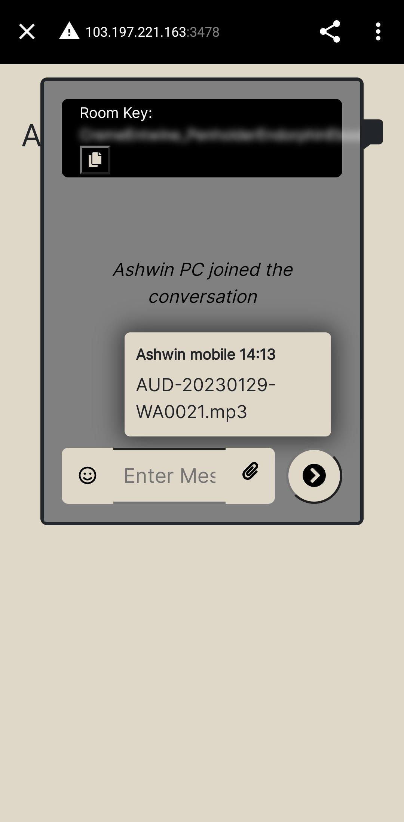
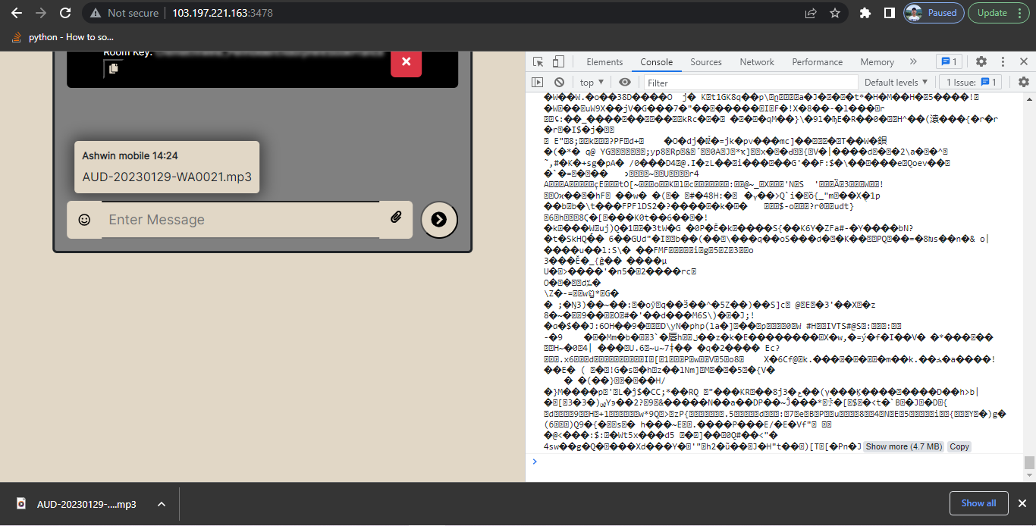
Screenshots
Mobile-Desktop
File details: Type - mp3 audio, File size - 2.42 MB, Audio length - 2 minutes 38 seconds
Receiver
Sender

Slide 62

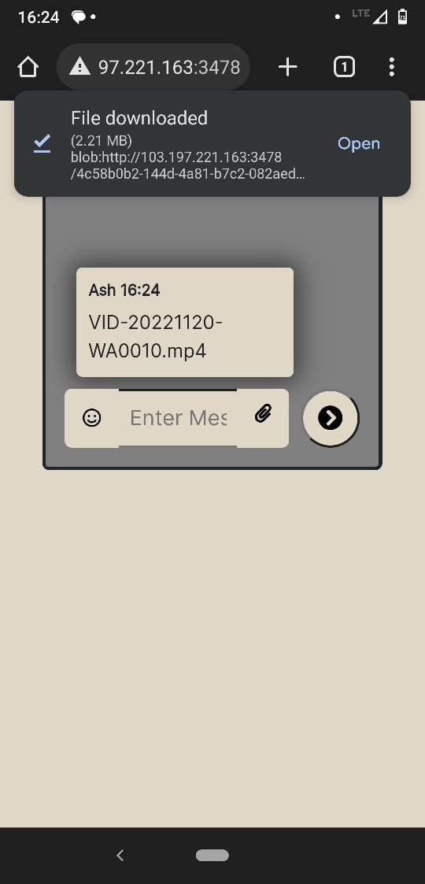
Screenshots
Mobile-Mobile
File details: Type - mp4 video, Size - 2.2 MB, Video length - 11 Seconds
Sender
Receiver

Slide 63
Conclusion
Secure and Private communication is a serious issue in today’s world. One is not able to communicate with their loved ones without the fear of being spied on.
There is a serious lack of an Indie Secure Communication application which can be freely and securely used by the public.
This project can solve this by using private servers without any external entity interference.

Slide 64
Future Scope
Add functionality for authorization of users in the room
Add a storage mechanism for messages so that the messages are stored when the user is offline and are transmitted when the user comes back online
Increase transmission speed for file transfers by either optimizing encryption algorithm or improving network routing

Slide 65
References
Cohn-Gordon, K., Cremers, C., Dowling, B., Garratt, L., & Stebila, D. (2020) “A Formal Security Analysis of the Signal Messaging Protocol.” Journal of Cryptology 33 (4): 1914– 1983. https://doi.org/10.1007/s00145-020-09360-1
Raman Singh, Hitesh Tewari. (2021) “Blockchain-Enabled End-to-End Encryption for Instant Messaging Applications.” https://arxiv.org/abs/2104.08494
Botha, J.G., Van ‘t Wout, M.C. and Leenen, L. (2019) “A comparison of chat applications in terms of security and privacy.” 18th European Conference on Cyber Warfare and Security, University of Coimbra, Portugal.
Sabah, Noor & Mohamad, Jamal & Dhannoon, Ban N. (2017) “Developing an End-to-End Secure Chat Application.” International Journal of Computer Science and Network Security.
M. B. Kılıç , "Encryption Methods and Comparison of Popular Chat Applications", Advances in Artificial Intelligence Research, vol. 1, no. 2, pp. 52-59, Sep. 2021
Kseniia Ermoshina, Francesca Musiani, Harry Halpin. “End-to-End Encrypted Messaging Protocols: An Overview”. Internet Science. INSCI 2016. Lecture Notes in Computer Science(), vol 9934. Springer, Cham. https://doi.org/10.1007/978-3-319-45982-0_22
Discussion on projects using XMPP-based Instant Messaging on https://xmpp.org/uses/instant-messaging/
Document on the X3DH key agreement protocol on https://signal.org/docs/specifications/x3dh/
S. Blake-Wilson, D. Johnson, and A. Menezes, “Key agreement protocols and their security analysis,” in Cryptography and Coding: 6th IMA International Conference Cirencester, UK, December 17–19, 1997 Proceedings, 1997. http://citeseerx.ist.psu.edu/viewdoc/summary?doi=10.1.1.25.387
Overview of XMPP https://xmpp.org/about/technology-overview.html
Document on double ratchet algorithm on https://signal.org/docs/specifications/doubleratchet/
T. Perrin and M. Marlinspike, “The X3DH Key Agreement Protocol,” 2016. https://whispersystems.org/docs/specifications/x3dh/

